Slide 1
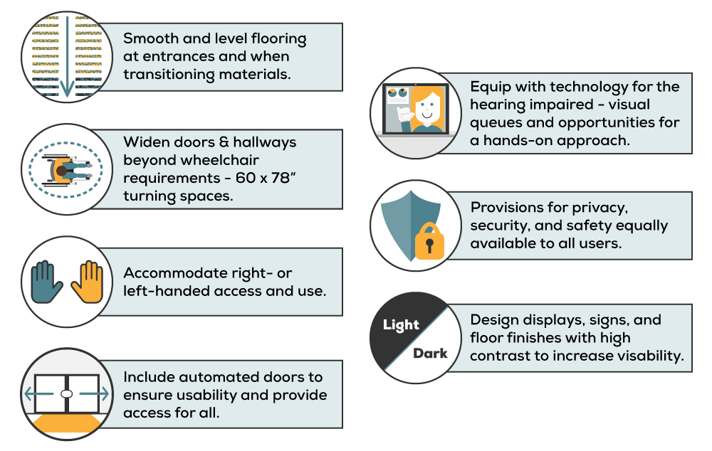
Design Challenge Day

Slide 2
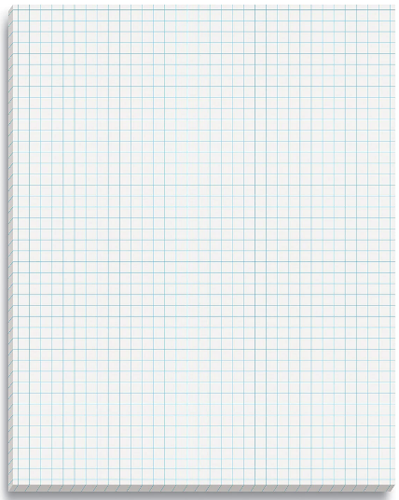
How will you apply what you have learned to the design challenge?
Notes:
Slide 2, Review with students that they will choosing a card from the interior design challenge kit. They will design a floor plan based on the scenario they chose and use the materials provided to draw their floor plan within the time allotted.

Slide 3
Universal principle 1
Universal principle 2
5’-0”
Universal principle 3
Universal principle 4
Universal principle 5
FLOOR PLAN
Notes:
Slide 3, show students an example of the design challenge they should be drawing. They should indicate the universal design principles used in their drawings.

