Slide 1
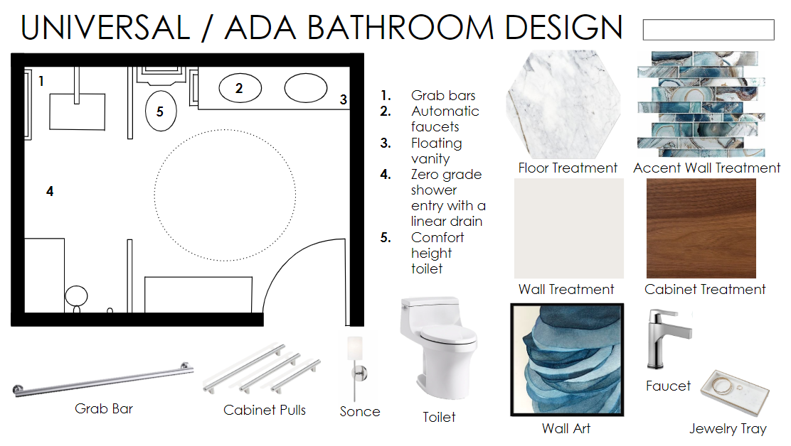
Designing for Accessibility

Slide 2
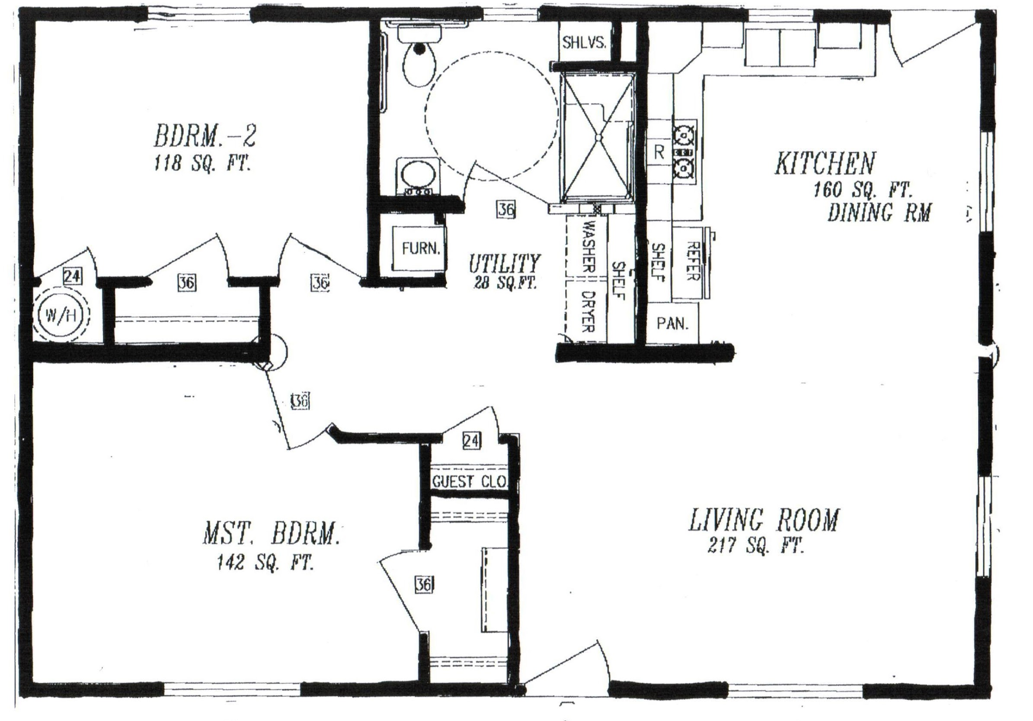
How will you apply the universal design principles to design for accessibility?
Notes:
Review with students that they will be moving through stations around the room that have simulations of physical disabilities. They will design a floor plan that caters to each of the physical disabilities and must use the universal design principles to guide their design.

Slide 3
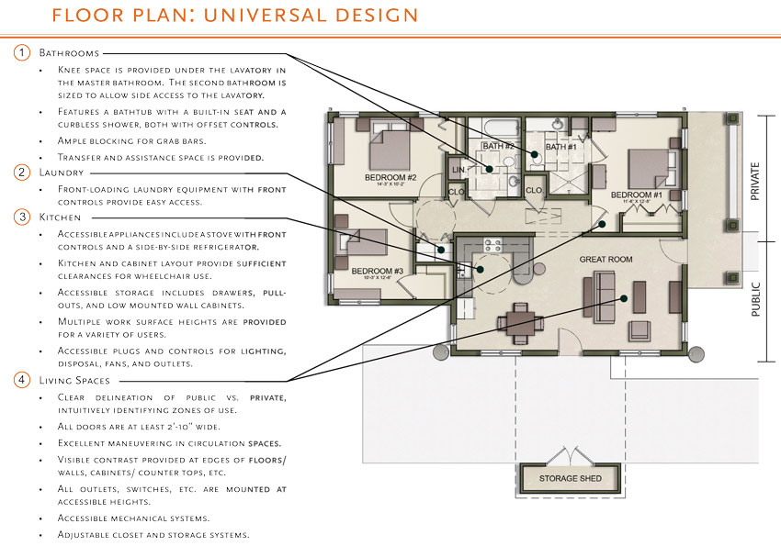
Sample Floor Plan 1
Notes:
Slide 3. Review the elements of this floor plan with students and ask them which principle of universal design is represented in each room

Slide 4
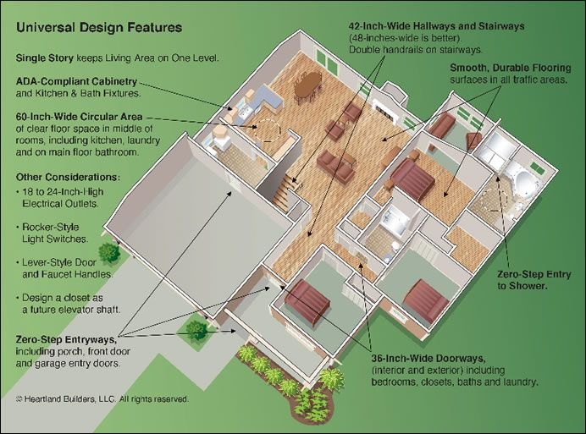
Designing for Accessibility: Sample Floor Plan 2
Notes:
Slide 4, review the elements of this floor plan with students and ask them how the universal design principles shown can address different physical disabilities

Slide 5
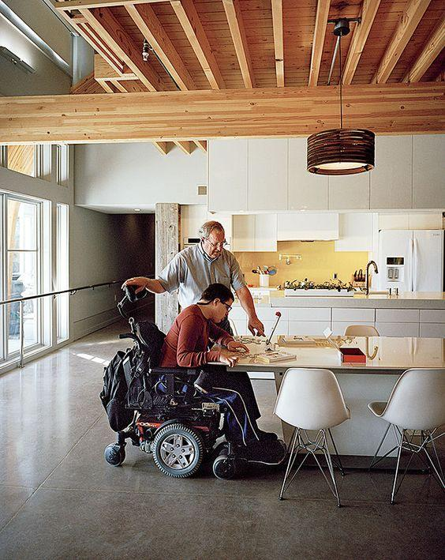
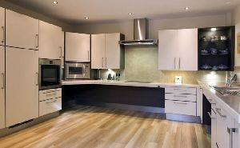
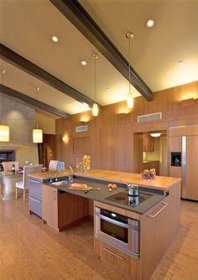
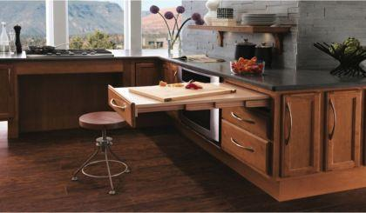
ADA Universal Kitchens
Notes:
Slide 5, review these examples of universal kitchens with students

Slide 6
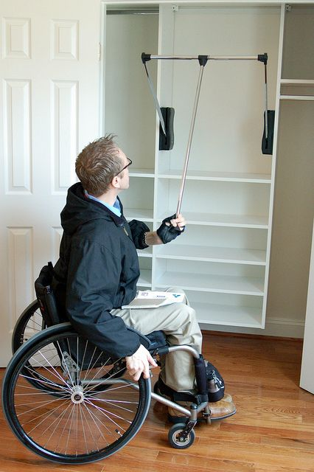
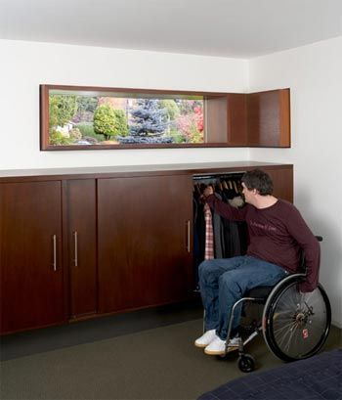
ADA Universal Closets
Notes:
Slide 6, review these examples of universal closets with students

Slide 7
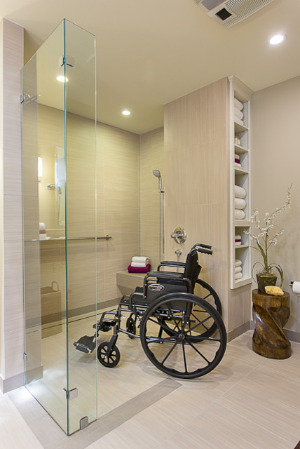
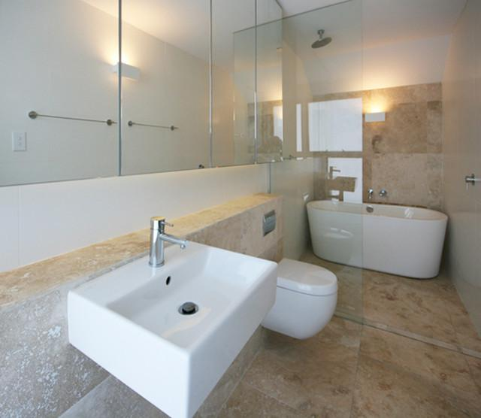
ADA Universal Bathrooms
Notes:
Slide 7, review these examples of universal bathrooms with students

Slide 8
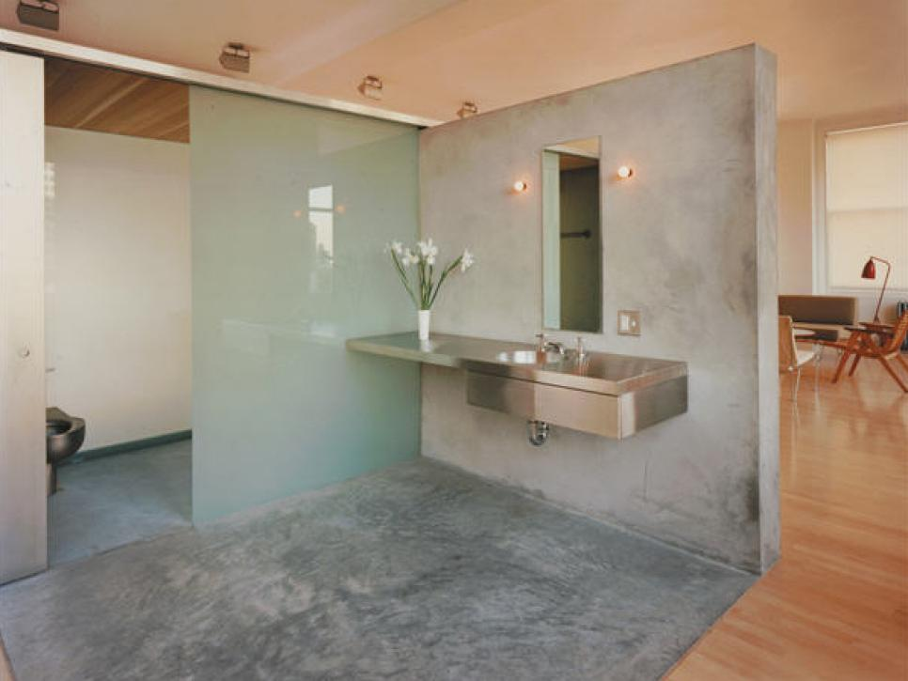
ADA Universal Bathrooms cont’d
Notes:
Slide 8, review these examples of universal bathrooms with students

Slide 9
For more information please contact Realityworks, Inc.
through email at information@realityworks.com
or call toll free at 800.830.1416

