Slide 2
Teaching Math in your Trade Skills Program

Slide 3
Objectives
Find tips for teaching basic math skills
Discover ideas for integrating foundational math concepts into your CTE lessons
Free resources!!
BONUS: Learn about the Realityworks Measurement Math Training Kit

Slide 4

What Do They Need to Know?
Basics
  Decimals
  Fractions
  Ratios
  Conversions
  Measurements

Slide 5
How can we help teach?
Context
Bite Sized Chunks
Integration
Gamification
Multiple Modalities

Slide 6
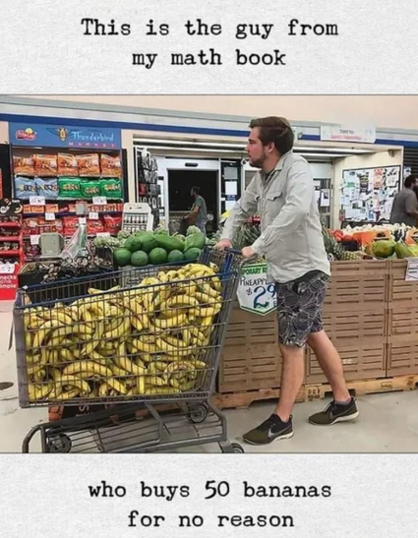
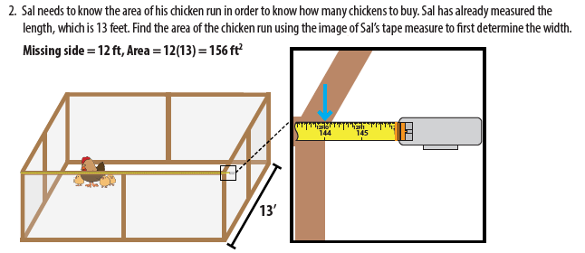
Context

Slide 7
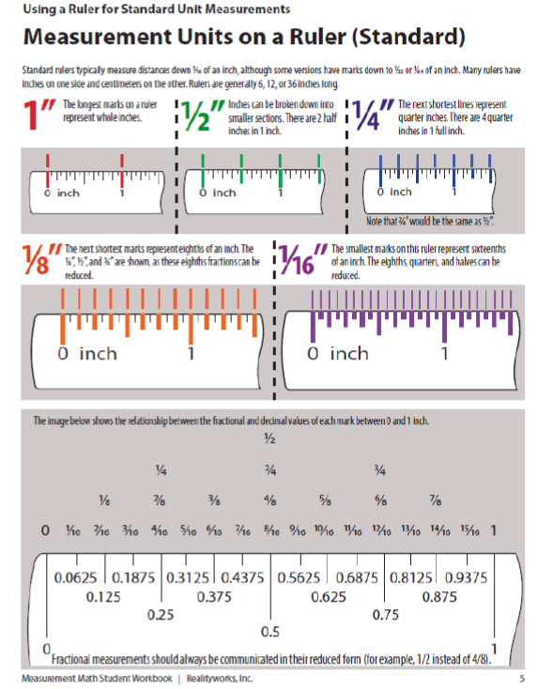
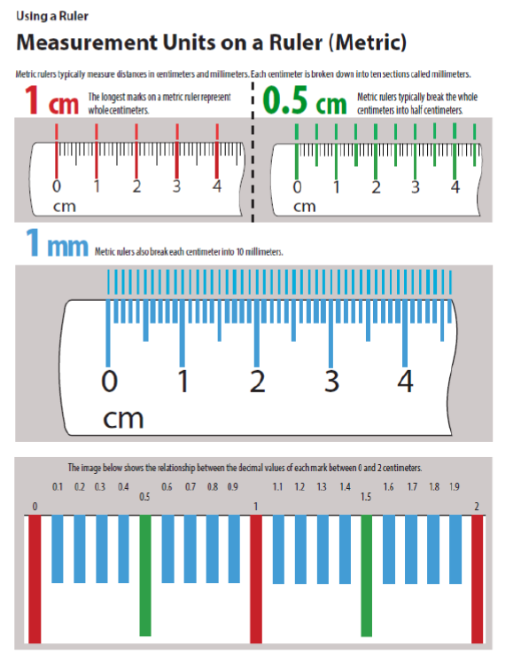
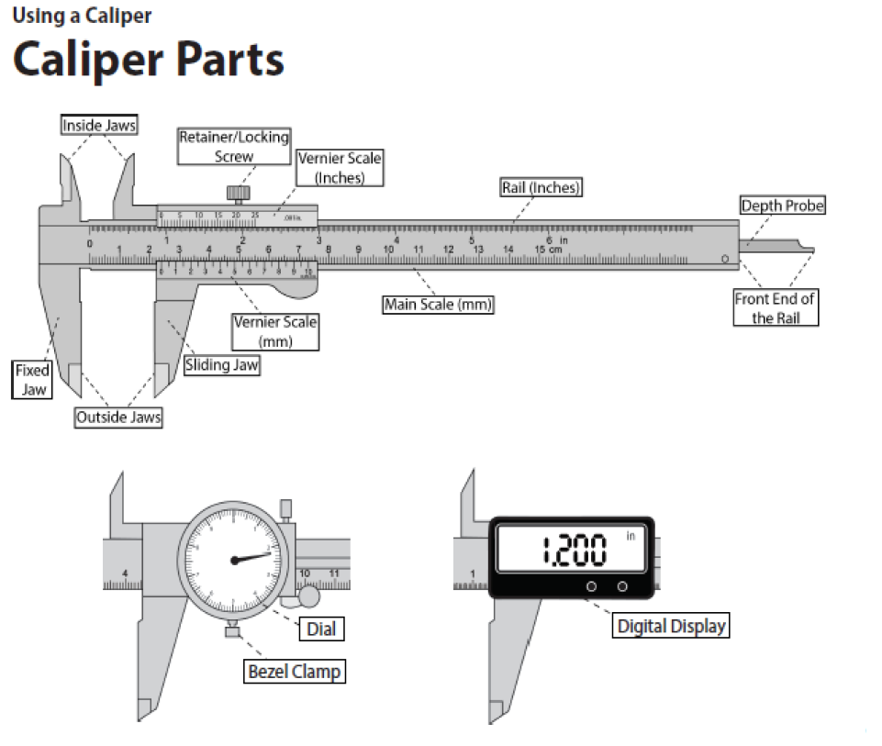

Bite Sized Chunks

Slide 8
Integration
Conversion
Decimals
Decimals to Fractions
Metric
Fractions
Standard
Ruler
Tape Measure
Caliper
Add/Subtracting
Multiplying/Dividing
Fractions to Decimals
Combining Measurements
Measurement Practice
Assessment Opportunity
Measurement Practice
Real World Practice
Real World Practice
Assessment Opportunity

Slide 9

Gamification
Measurement DAY
Online Resources
Create Challenges for Student
Create Real Work Experiences -
Running Scoreboard
Measurement Goals/Awards

Slide 10
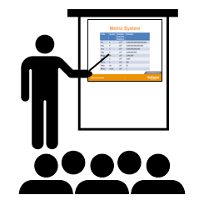
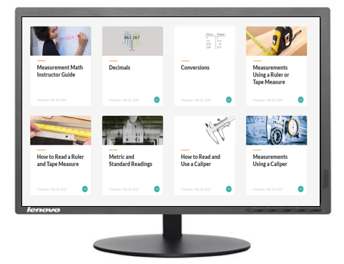
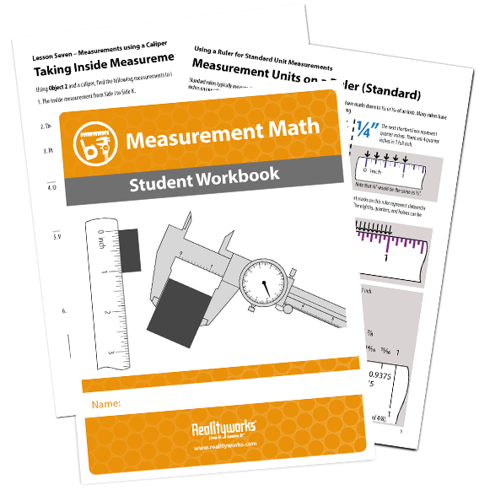
Multiple Modalities

Slide 11
Measurement Math
Training Kit

Slide 12
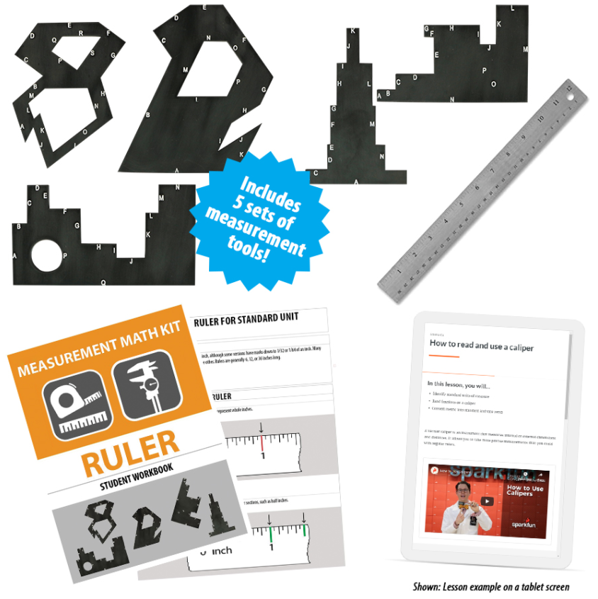
Measurement Math Training Kit
Includes:
  5 sets of measurement tools
  Online curriculum option
  Classroom curriculum option
  Student Workbooks
  Instructor guide

Slide 13

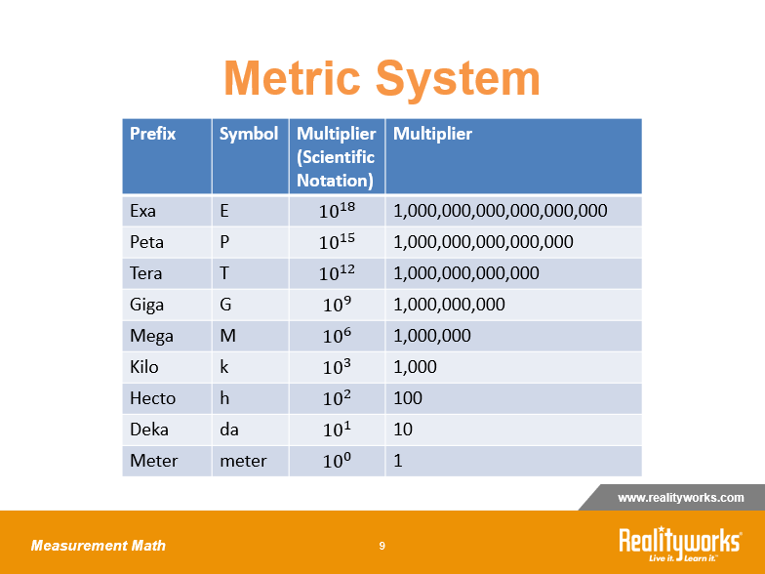

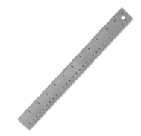
Focused measurement learning
5 Sets of Measurement Tools
1
2
Classroom Curriculum
3
4
20x
Online Curriculum
5

Slide 14
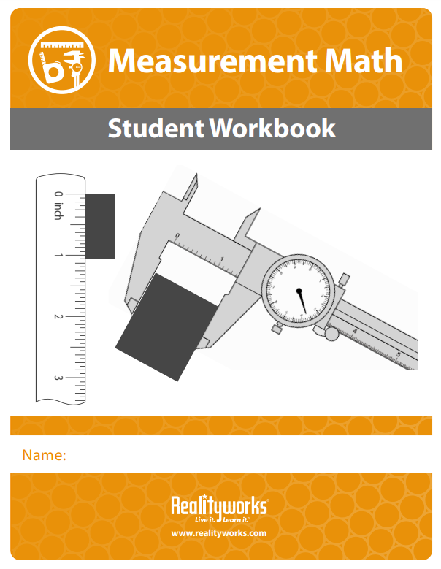
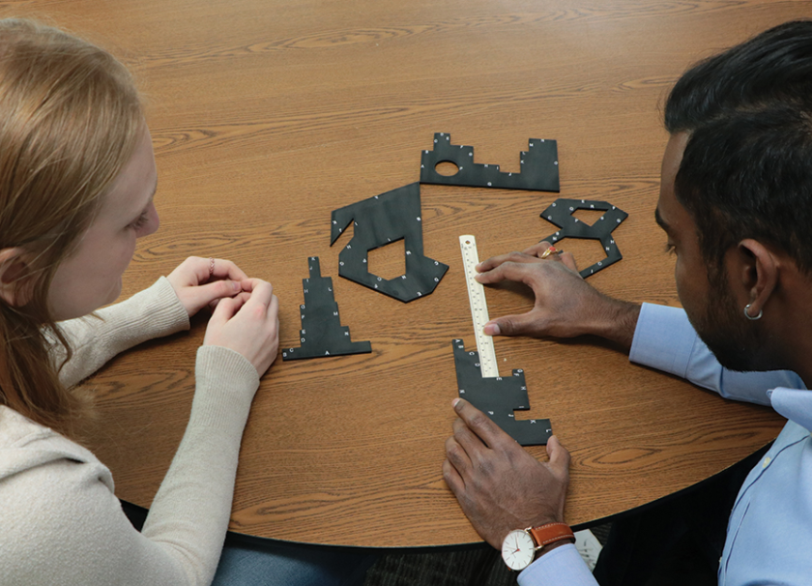
Measurement Tools
100’s of measurements

Slide 15
Curriculum

Slide 16
Measurement Math Lessons
Lesson 1: Metric and Standard Readings
Lesson 2: How to Read a Ruler/Tape Measure
Lesson 3: How to Read/Use a Caliper
Lesson 4: Decimals
Lesson 5: Conversions
Lesson 6: Measurements Using a Ruler or Tape Measure
Lesson 7: Measurement Using a Caliper

Slide 17
In-Class Curriculum
Videos
Presentation Slides
In-Class Activities

Slide 18
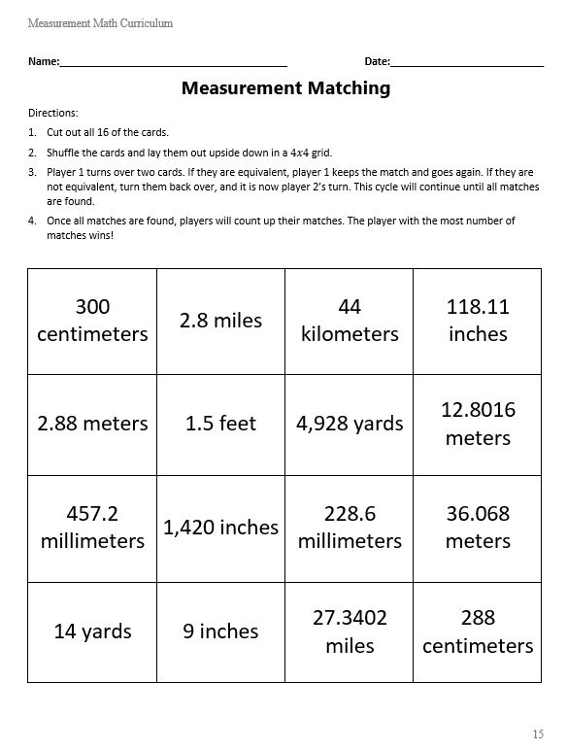
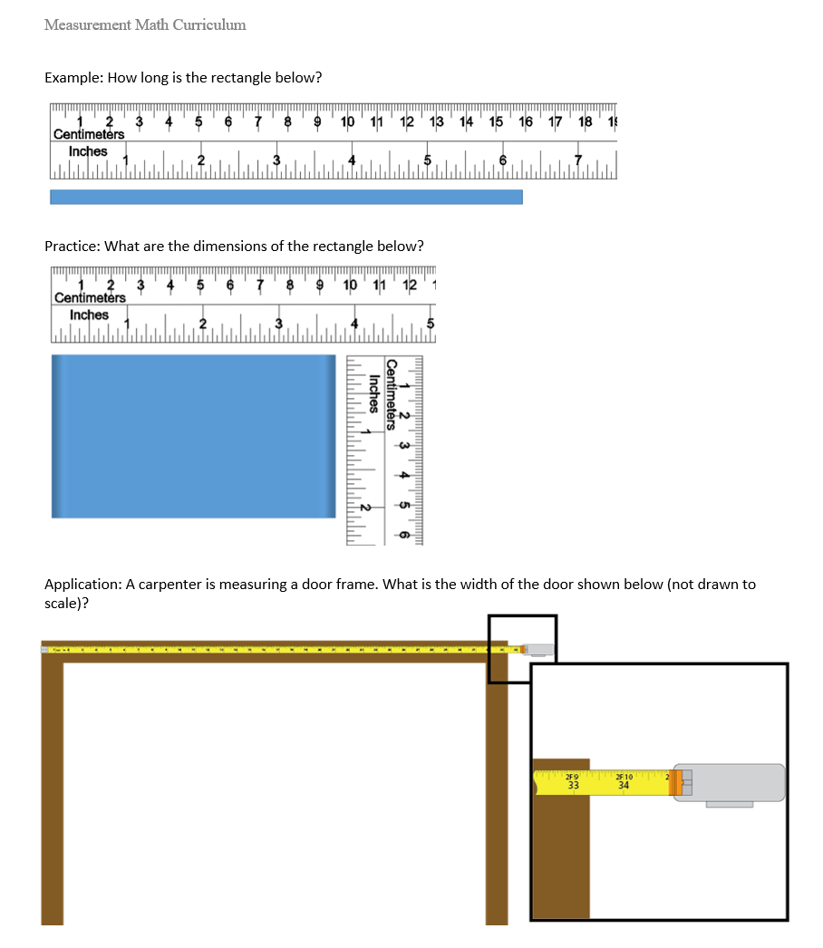
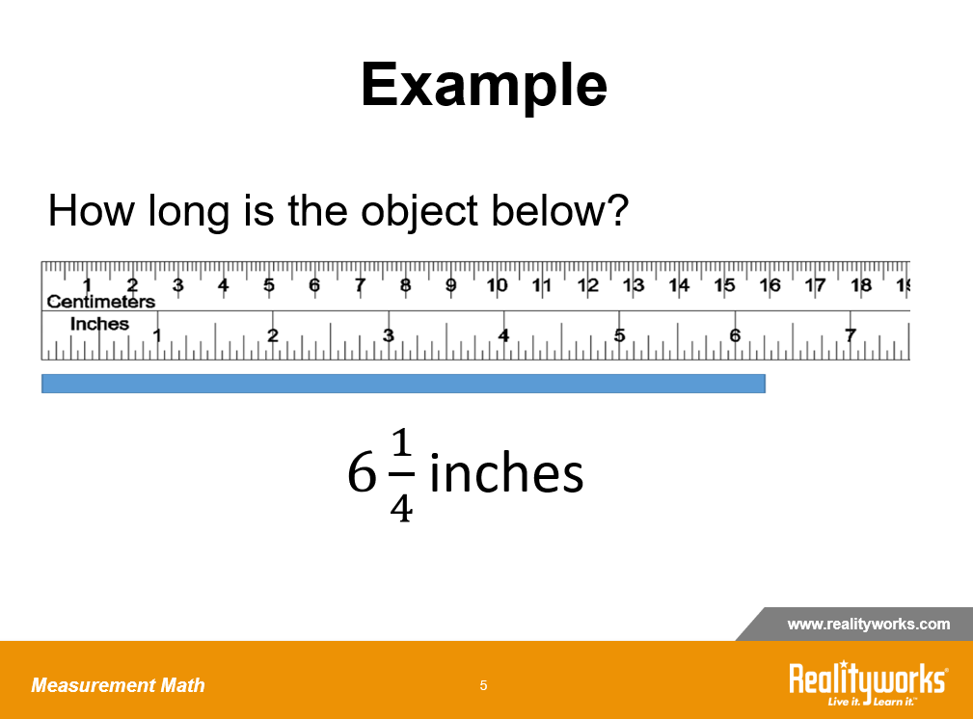
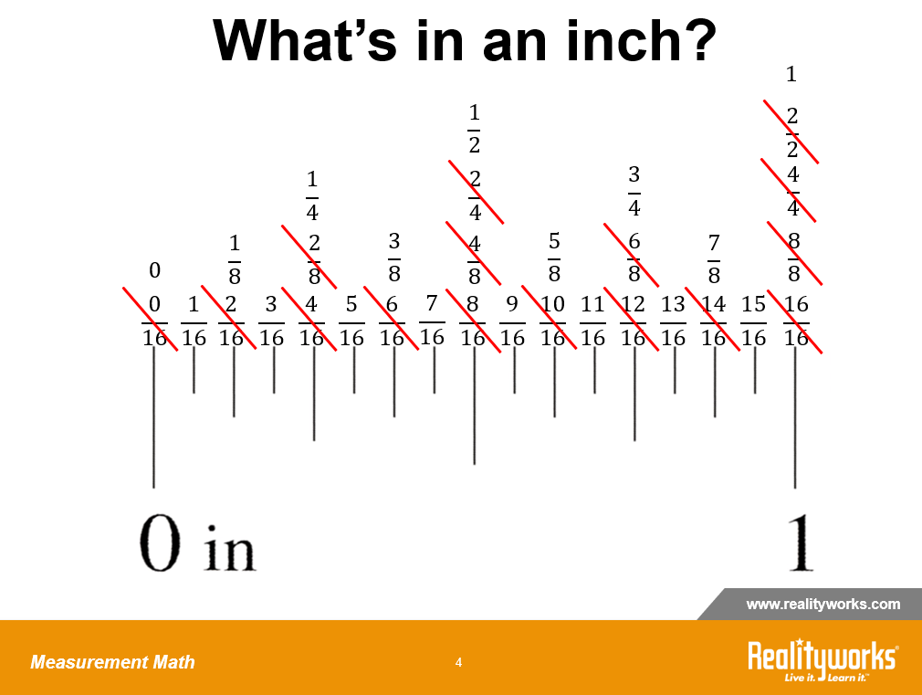
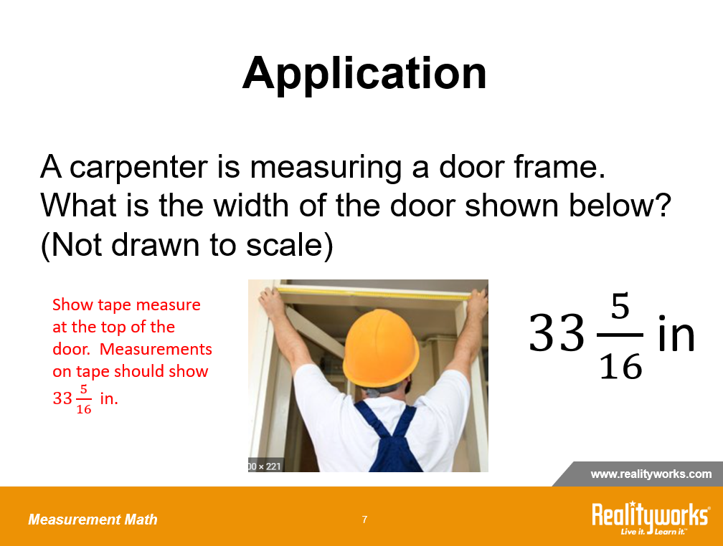
Classroom Curriculum
Worksheets
Presentation Slides
Workbooks

Slide 19

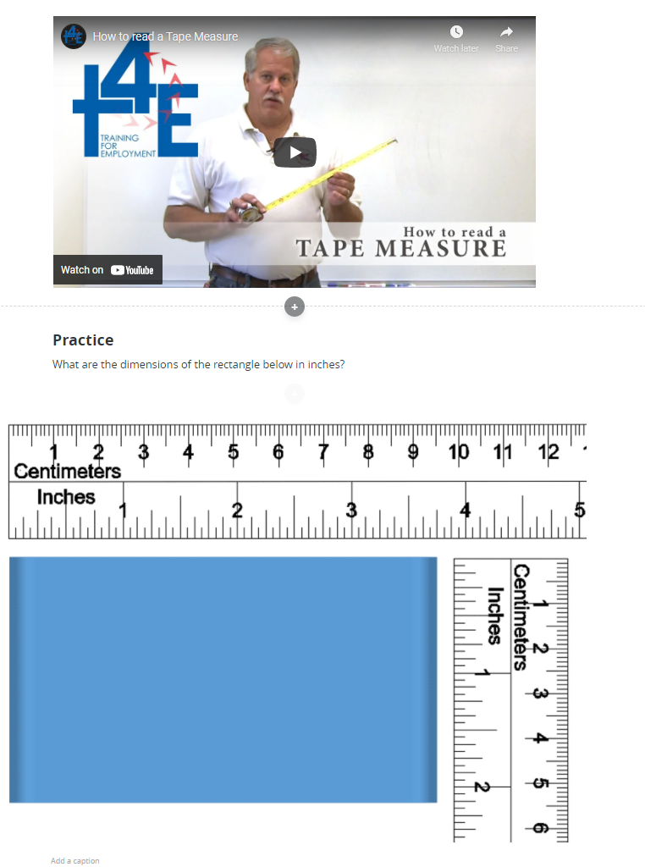
Online Curriculum
Videos
Knowledge Checks
Online Activities

Slide 20
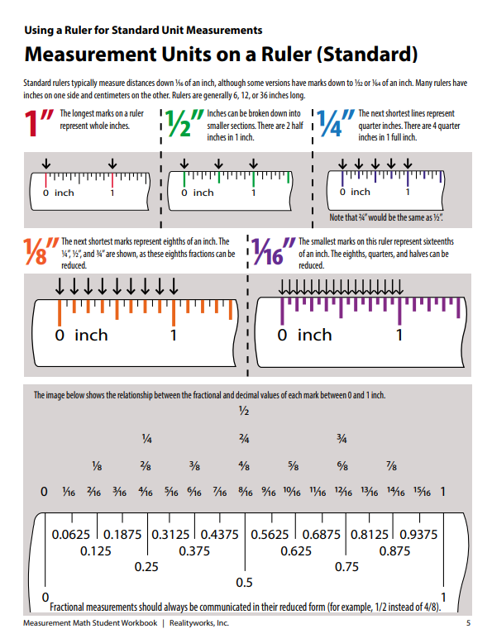
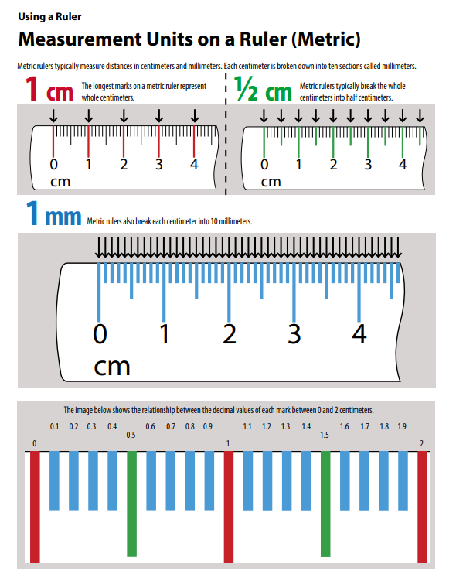
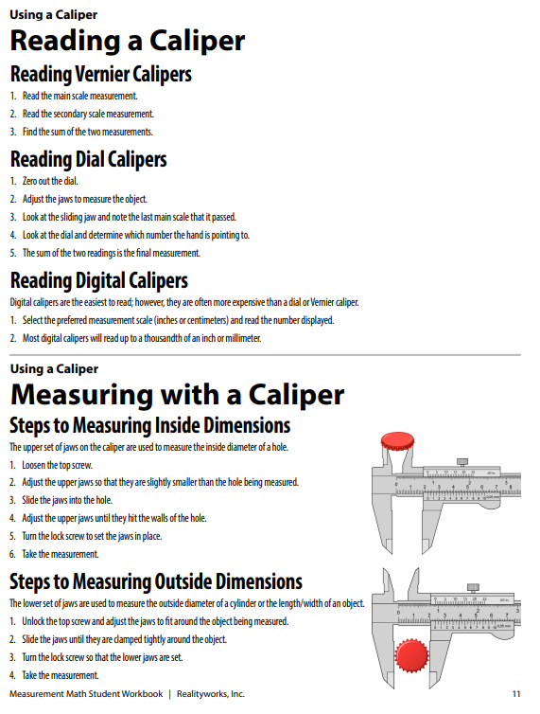
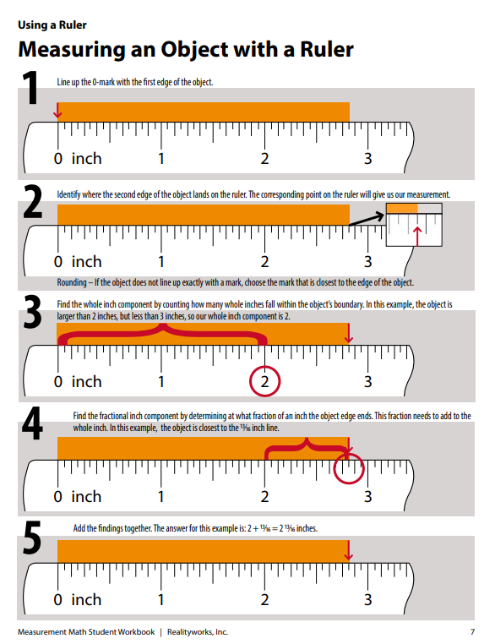
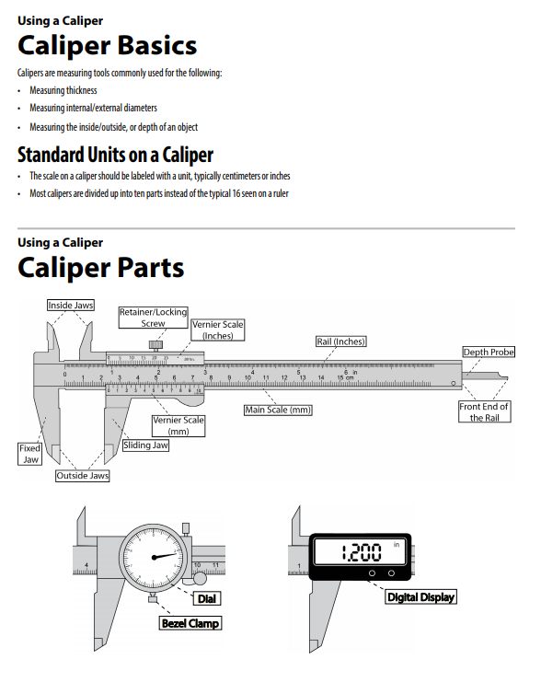
Student Workbooks

Slide 21
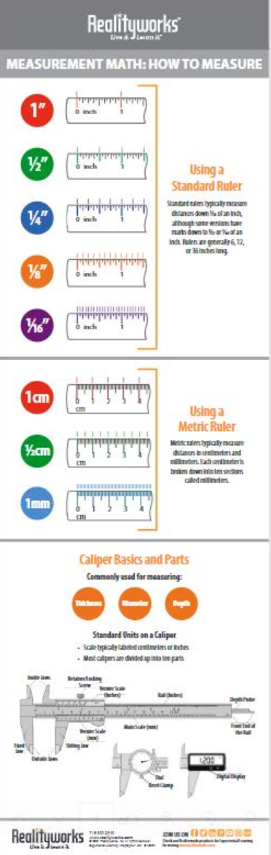
Free Resources
Thank you for being a part of this webinar!
We will be emailing you a free Measurement Math: How to Measure Infographic.
This poster can be printed out and posted in your classroom!

Slide 22
Q&A

