Slide 2
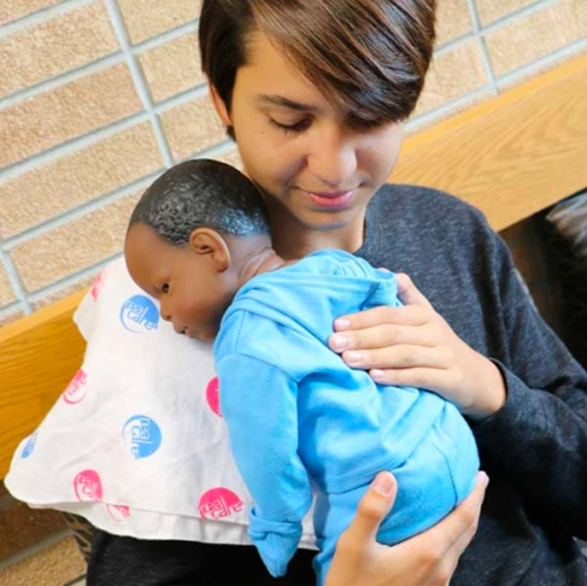
RealCare Baby® Best Practices Teacher Showcase
Notes:
Are you looking for great activities for using RealCare Baby? Do you wish you had a brilliant way to keep your accessories organized? This webinar will showcase customer ideas. We get our best activities, time-saving ideas and innovative ways for using RealCare Baby from teachers who use Baby. Educators from across the country have submitted their best practices and we are excited to spread the word!
Attendees will:
Find new ways to use RealCare Baby
Come away with time-saving ideas and organizational tips
Inspire others to use their creativity for engaging Baby in the classroom

Slide 3
Agenda
Best Practices for Using Realcare Baby
Organizational Tips
Free Resources
Q&A
Notes:
Are you looking for a great activity for using RealCare Baby? Do you wish you had a brilliant way to keep your accessories organized? This webinar will showcase customer ideas. We get our best activities, time-saving ideas and innovative ways for using RealCare Baby from teachers that use Baby. Educators from across the country have submitted their best practices and we are happy to spread the word!
Attendees will:
Find new ways to use RealCare Baby
Come away with time-saving ideas and organizational tips
Inspire others to use their creativity for engaging Baby in the classroom

Slide 4
Best Practices for Using RealCare Baby

Slide 5

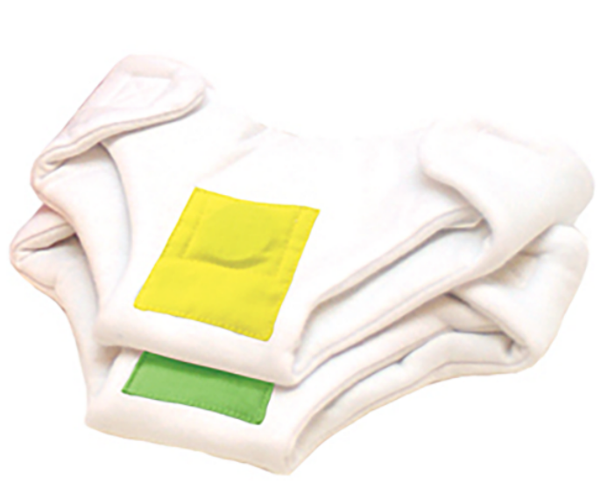
Best Practices from Arkansas
Have my students sign up for a specific baby for a specific weekend (F-M)
Choose one 3 hour quiet time during the weekend
Keep all of the diaper bags ready to go at a moment's notice. I place the wristband with the appropriate ID in a ziplock baggie with a (sticky note) label showing which baby the bag belongs to.
Have my students dress their baby with clean clothes and check that their diaper bag has an extra set of clothes and 2 diapers
Gloria Woods Seward
Family and Consumer Sciences Teacher
White County Central High School
Judsonia AR
Notes:
My routine is to have my students sign up for a specific baby for a specific weekend (F-M). I start the time at 4:00 each Friday and it stops on Monday at 7:00 am. I allow the students to choose one 3 hour quiet time during the weekend (usually church time) as a courtesy to them. If students have extenuating circumstances, I will customize the start and stop times.
I like to keep all of the diaper bags ready to go at a moment's notice. I place the wristband with the appropriate ID in a ziplock baggie with a (sticky note) label showing which baby the bag belongs to.
I have my students dress their baby with clean clothes and check that their diaper bag has an extra set of clothes and 2 diapers (must be two different colors).

Slide 6
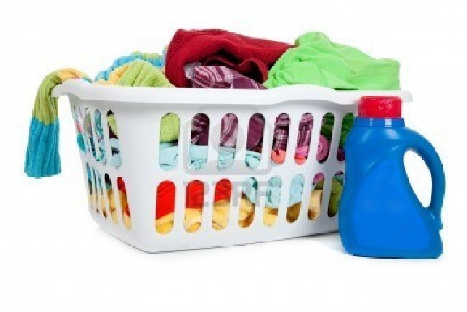
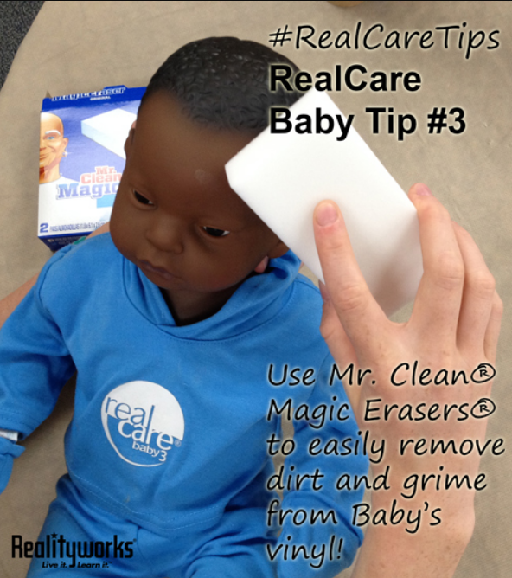
Best Practices from Arkansas
Check to make sure that all items are returned and check the level of care taken with the baby, car seat, and equipment.
Place all the clothes in a basket to be washed during the week and replace in the diaper bags before Friday.
Have volunteers use a baby wipe to sanitize.
Replenish the bracelets (wristbands) into the baggies.
By the next day the babies should be ready to check out again.
Gloria Woods Seward
Family and Consumer Sciences Teacher
White County Central High School
Judsonia, AR
Notes:
When I receive the RealCare Babies back, I check to make sure that all items are returned and check the level of care taken with the baby, car seat, and equipment. (I complete the appropriate responses on the Assessment one at a time.)
I then place all the clothes in a basket to be washed during the week and replace in the diaper bags before Friday, which is the day all babies are checked out.
I have volunteers to use a baby wipe to sanitize the baby, the carseat, and the diaper bag, straps, etc., placing the babies in the charging compartment and plugging them in.
Then we replenish the bracelets (wristbands) into the baggies being careful not to get them mixed up.
By the next day the babies should be ready to check out again.

Slide 7
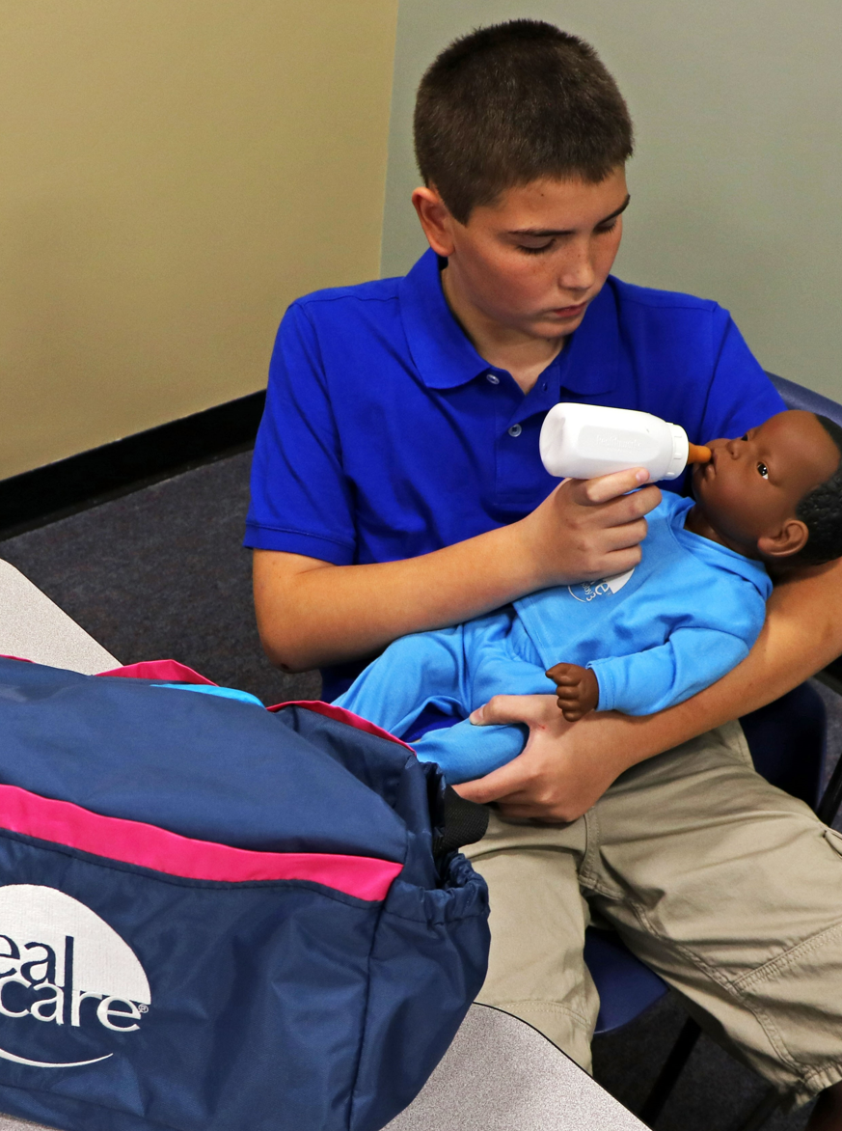
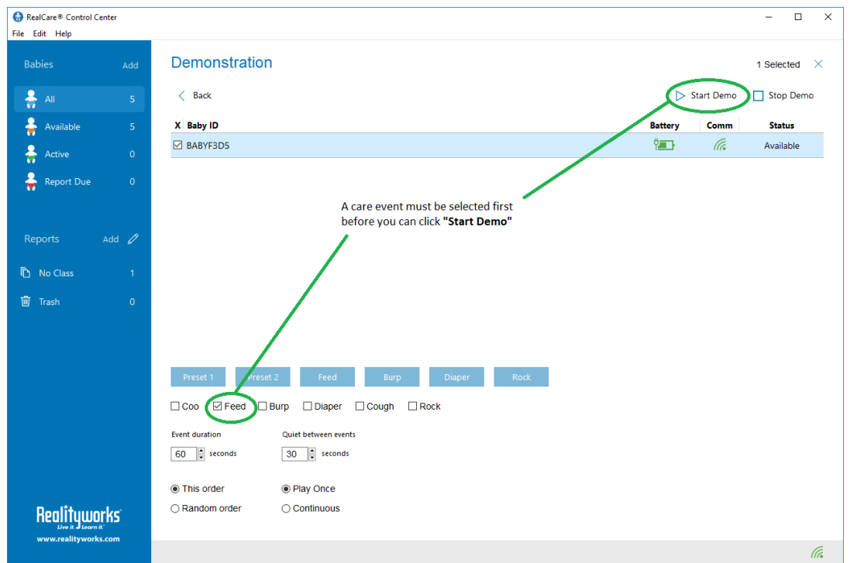
Best Practices from Minnesota
I have designed a 3-part RealCare Baby experience.
First, we practice with the Simulator Demo Activity over several days.
Julie Coopet
FCS Teacher Mounds View High School
Arden Hills, MN

Slide 8

Best Practices from Minnesota
Each student who participates in the "take-home" experience completes:
1) a pre-survey
2) a during-survey
3) a post-survey -
Parent Interview paper - Alternative
Julie Coopet
FCS Teacher Mounds View High School
Arden Hills, MN
Notes:
Each student who participates in the "take-home" experience completes:
1) a pre-survey - asking how they feel about taking the simulator home
2) a during-survey - asking a few (short) reflections on their experience at that time
3) a post-survey - more in-depth questions about how the simulator affected their life
I also offer a Parent Interview paper for those students who don't want to take the simulator home

Slide 9
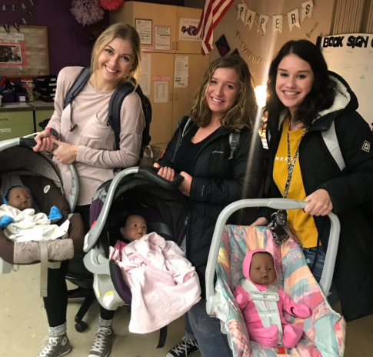
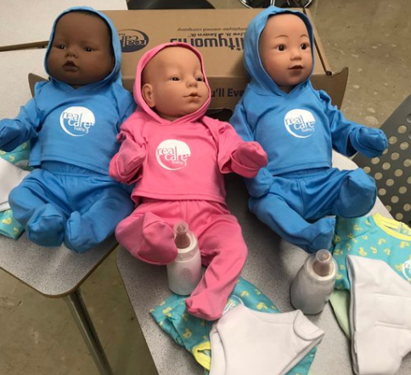
Best Practices from Minnesota
Use in multiple classes
Junior High – Babysitting Unit
High School – Weekend Simulation Opportunity
Krysten Dane
FCS Instructor
MAFCS President
Glencoe-Silver Lake School
Glencoe, MN
Notes:
Here is a submission from Krysten Dane describing some of the things she does at GSL with the infant simulators and a student quote from her experience.
We utilize the infant simulators in multiple classes at GSL. The junior high students first get to
experience the simulators in our babysitting unit, learning the basic cares for infants; bottle
feeding, diaper changes, clothing changes, swaddling, burping etc. I set these up in interactive
stations. Students work in small groups. There is an iPad set up with a video clip &/or
instructions to accompany their paper activity guides.
At the high school level students in Infants get the opportunity to take the simulators home for a weekend (Friday after school until Monday morning). We spend time in class practicing
with the simulators before students begin taking them home to help them gain a level of
comfort and confidence for a successful weekend ahead. There is an alternative assignment for those students unable to take the baby home.

Slide 10
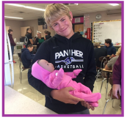
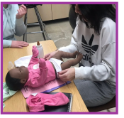
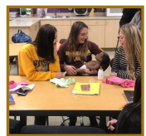
Best Practices from Minnesota
Organization Tips
Staying organized is key.
Program the simulators the night before.
Schedule the start time when I plug them in to charge.
Krysten Dane
FCS Instructor
MAFCS President
Glencoe-Silver Lake School
Glencoe, MN
Notes:
With so many simulators, staying organized is key. I try to keep all of the clothes, bottles, diapers, IDs, student cards, etc. are all in the diaper bag that is then placed in the car seat and labeled for each corresponding simulator. I have found it very helpful to program the simulators the night before and schedule the start time when I plug them in to charge to eliminate scrambling to program when students come to pick up their baby.

Slide 11
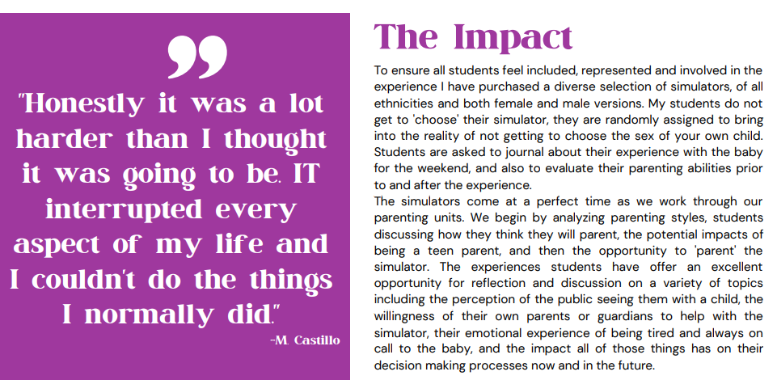
Best Practices from Minnesota
Krysten Dane
FCS Instructor
MAFCS President
Glencoe-Silver Lake School
Glencoe, MN
Notes:
This student quote is great. (read quote)
A few of the important parts of the impact which you can read are the purchase of diverse selection of skin tones and gender. Journaling is always a best practice we highly encourage you to use.
The Simulation also offers rich post-simulation discussion and reflection on the experience.

Slide 12

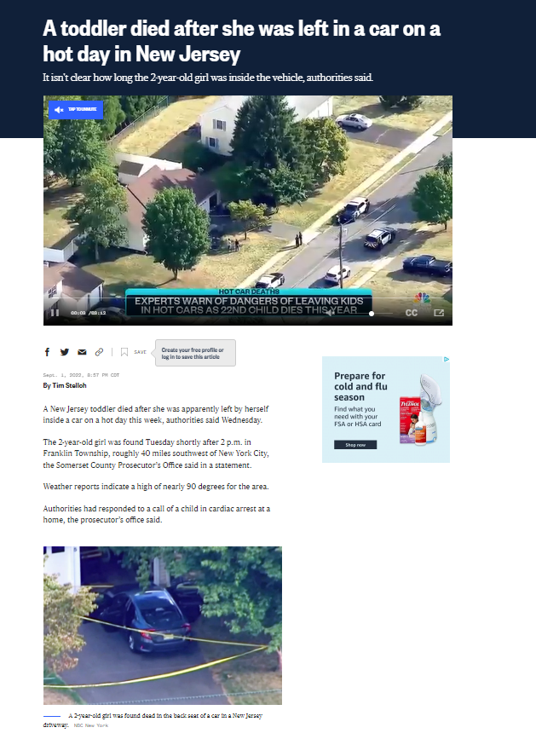
Best Practices from Iowa
Hidden Gem: Hypo and hyperthermia lesson
Treat it like a real child! The police will…..
Use videos of real people for greater impact
This is a lesson I really want to hit home with them and I know they are paying close attention.
Becky Stanbrough
FCS Teacher
Red Oak High School
Red Oak, Iowa
Notes:
In your materials, there are a lot of other 'sometimes missed' materials. The one I like to share with my students is about Hypo and Hyperthermia. I have a whole lesson on this as Iowa (where we are) has both extreme cold and hot weather conditions.
When they take their baby home, although they know it's not a real child, I want them to think about leaving the baby in the car. I tell them they may be questioned by people who don't know this is a computer baby. I tell them they may have the police called on them if a stranger hears a baby crying in the back of an unattended car.
They need to know how serious this is and we cover a couple of videos of people who have lost their baby to a heated car when their child was forgotten.
This is a lesson I really want to hit home with them and I know they are paying close attention.

Slide 13
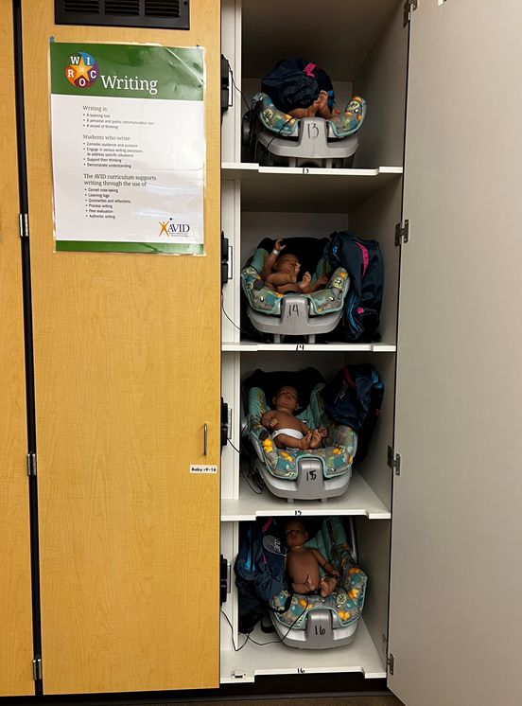
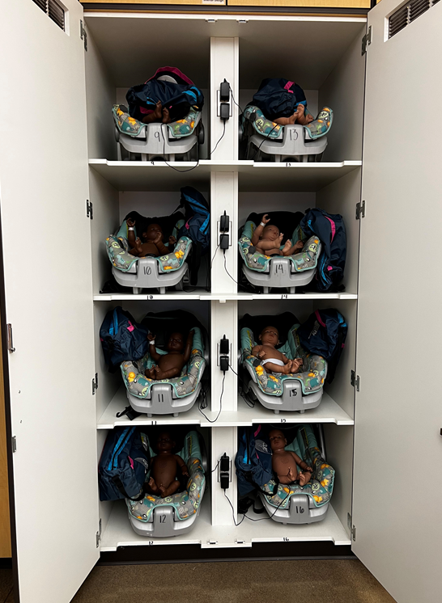
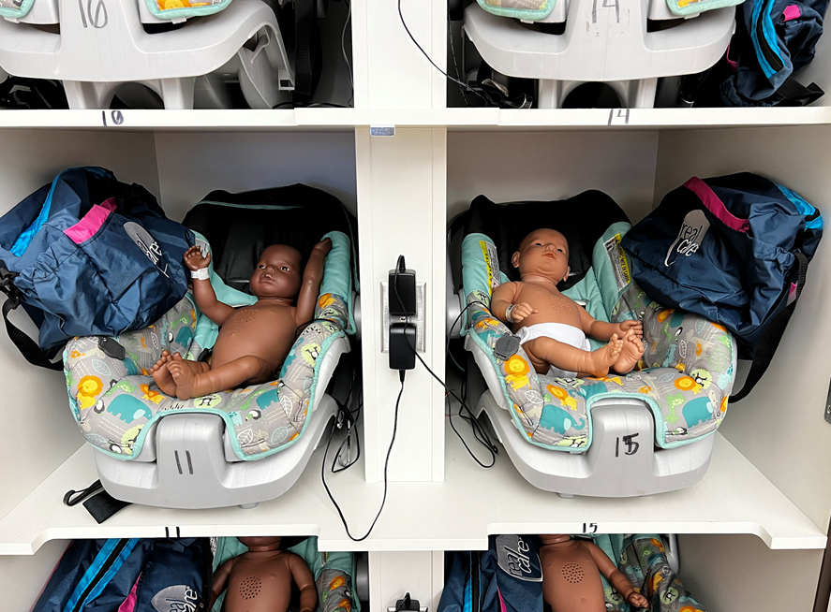
Best Practices from Oregon
Custom storage cabinets!
Hillary Mehlhoff
FCS Teacher/FCCLA Advisor
South Albany High School
Albany, OR
Notes:
Here is a great idea from Hillary Mehlhoff who has custom storage cabinets for the real care babies. This was the silver lining after losing my entire classroom to a school fire. If you have a shop class, that focuses on cabinet making, this could be a great project for them also.

Slide 14
Best Practice Tips From Our Blogs

Slide 15
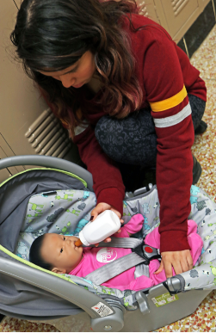
More Tips
Use the free RealCare Baby program resources available at Realityworks.com.
Give students more accountability over their Baby experience by using sign-up forms.
Send the Babies home for at least a 48-hour period.
Make the most of your students’ Baby experiences by using Baby’s software.
Use the Real Care Baby App!
Lauren Williams McCracken County High School
Notes:
Lauren Williams currently teaches early elementary education courses, including a Parenting class, at McCracken County High School. With 19 years of teaching experience, she has a wealth of knowledge and practice working with different schools and programs. Lauren uses RealCare Baby® infant simulators in her Parenting classes and says she would recommend all teachers use the babies.
“The principle came to my room the first year I did these. He told me that a mother called him and told him it was the best project her daughter had ever completed while in high school. He’s very supportive of the program.”
Use the free RealCare Baby program resources available at Realityworks.com.
“It is a wonderful site,” said Lauren. “I use the sign-up forms along with the parent permission forms.”
Give students more accountability over their Baby experience by using sign-up forms.
“I post sign-up forms at the beginning of the semester, and it is the student’s responsibility to write their name in for a weekend to bring a Baby home,” said Lauren.”
Send the Babies home for at least a 48-hour period.
“I do think it is best to do a 48-hour simulation on the weekend. I will schedule some quiet times if a student cannot get out of work shift. They do however have to make up the time at the end,” said Lauren. “If the simulation starts at 4 on a Friday, instead of turning off the Baby at 4 on Sunday, the time would be extended to compensate.”
Make the most of your students’ Baby experiences by using Baby’s software.
“I use the Infant Care Schedule Table to program active times. I tell everyone that a 48-hour simulation will usually yield about 50 care opportunities,” said Lauren. “I look at the schedules to see when most of these care opportunities will occur and assign them appropriately.”
Have students download the Real Care Baby App for how-to information, FAQs, video guides for caring for Baby, safety precautions and stress management tips.
“ONE OF THE MOST IMPORTANT TOOLS THAT HAVE HELPED MY STUDENTS AND MY SANITY!!! I insist that all students look at the app before they text me. I have had so many students tell me and other students that the app helped them.”

Slide 16
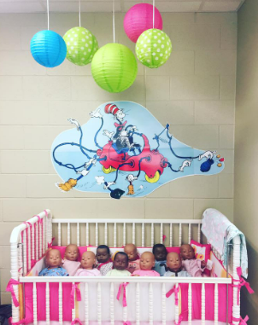
More Tips
Find ways to organize your supplies.
“I keep all of my supplies now in a little plastic 3 drawer cabinet beside the baby bed I brought from home. I placed the baby bed in front of an electrical outlet where I plug them in. The car seats are stacked by the bed.”
Have students help with your organization process for quick pick-ups and drop-offs.
“I have students turn in the babies with both diapers on. One on top of the other and we put the sensor bracelet down in the diaper too. This way, all the equipment needed is in one place. They get the doll, car seat, bottle and extra clothes quickly.”
Lauren Williams McCracken County High School

Slide 17

More Tips
10 RealCare Baby® Tips From Successful Users
1. Keep Each Baby’s Items in Their Own Container
2. Proper Preparation Is Key - Visit our RealCare Baby User Center to download
printable permission slips, deployment checklists, and more.
3. Let Students Practice During Class
4. Get Feedback From Parents/Guardians
5. Require Students To Take Baby Out on the Town
6. Encourage Open Communication With Students
7. Have Students Take Responsibility for Harming Baby
8. Take Advantage of Realityworks’ Resources
9. Experience the Simulation for Yourself
10. Keep Baby on Display
https://www.realityworks.com/blog/10-realcare-baby-tips-from-successful-users/
Notes:
Here is a blog we have featured with video interviews of pro-Baby users. If you’d like to read more details about how each of these tips are done, go to the link above.

Slide 18
Organizational Tips
Notes:
Here are some visual examples of how teachers around the country help keep themselves organized.

Slide 19
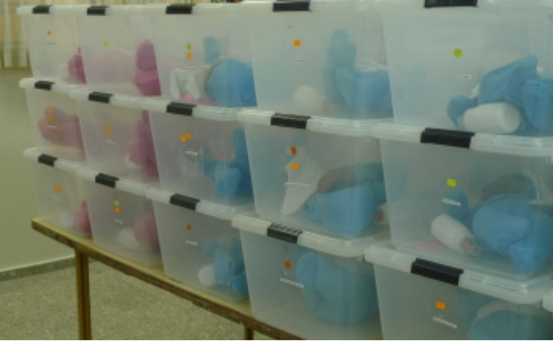
Baby Storage
Notes:
Totes and storage bins are a great way to keep everything together and organized. In this example, each tote has Baby along with the items the student will need for the simulation. Stacking totes also makes storage a breeze. The instructor in this example has color-coded the totes on the outside with circular stickers helping to identify different models that they are currently using.

Slide 20
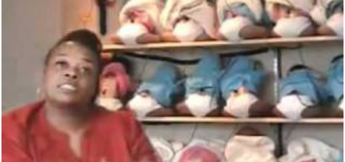
Baby Storage
Notes:
This image was taken from a video clip on YouTube of a RealCare Baby instructor. You can see that she stores her Babies on shelves which has access to outlets for charging purposes.

Slide 21
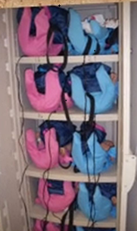
Baby Storage
Notes:
Here is another type of shelving system being used for baby storage.

Slide 22
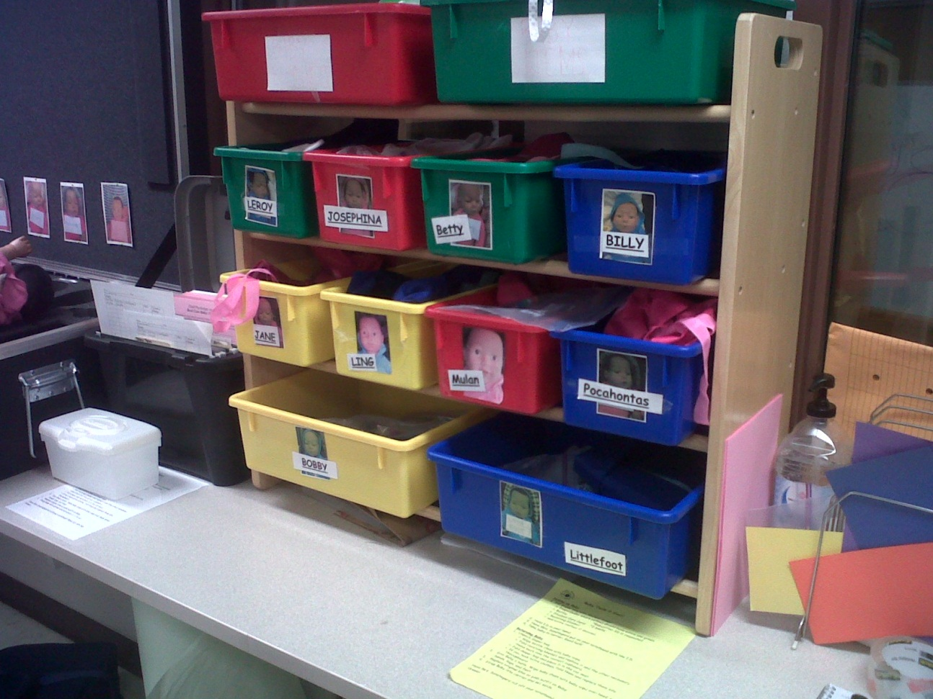
Accessories and Supplies
Notes:
This example shows a fun and easy way to keep supplies and accessories organized for each Baby. A photo of each RealCare Baby was taken and put on a bin designated specifically for that’s Baby’s items. This instructor has chosen to name each of her Baby’s and she has also taped the name of the baby to the bin with the photo of the Baby. At a glance, that instructor can take the bin with all of the supplies assigned to that Baby and check them in and out quickly. Each clothing item along with each supply has the Baby’s name written on them as well so that everything that goes with one specific Baby is identified.

Slide 23
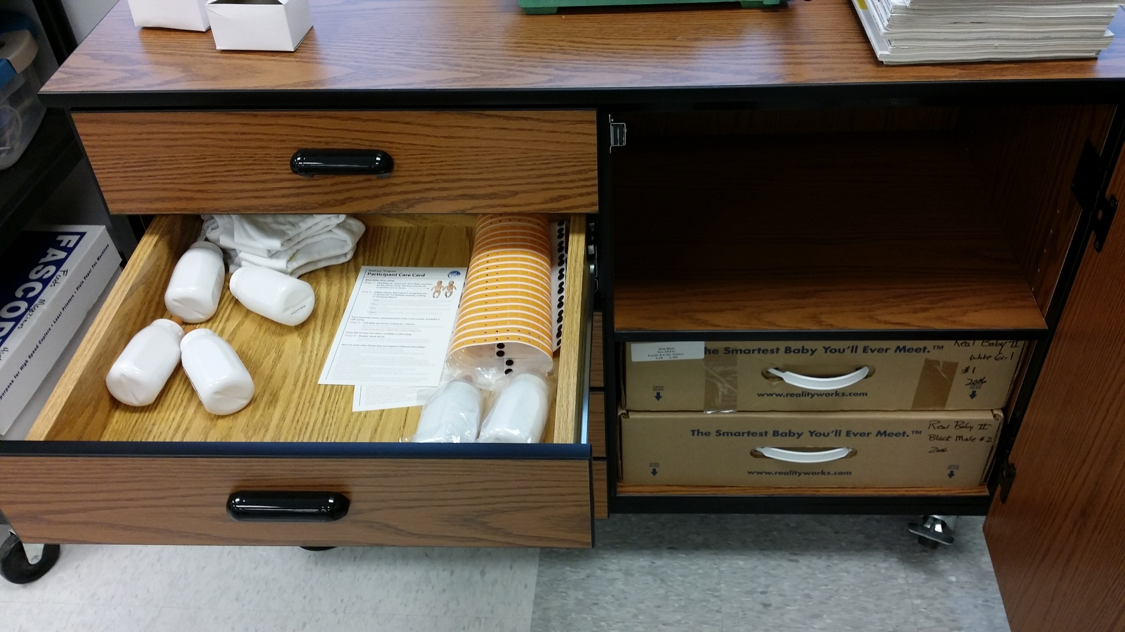
Babies, Supplies & Accessories
Notes:
Some creative customers around the country have found local storage solutions on wheels to purchase! This example was submitted by Beth Kiott from Floyd Johnson Tech CTE in York, SC. She Bought this cabinet that fits baby boxes and supplies perfectly!

Slide 24
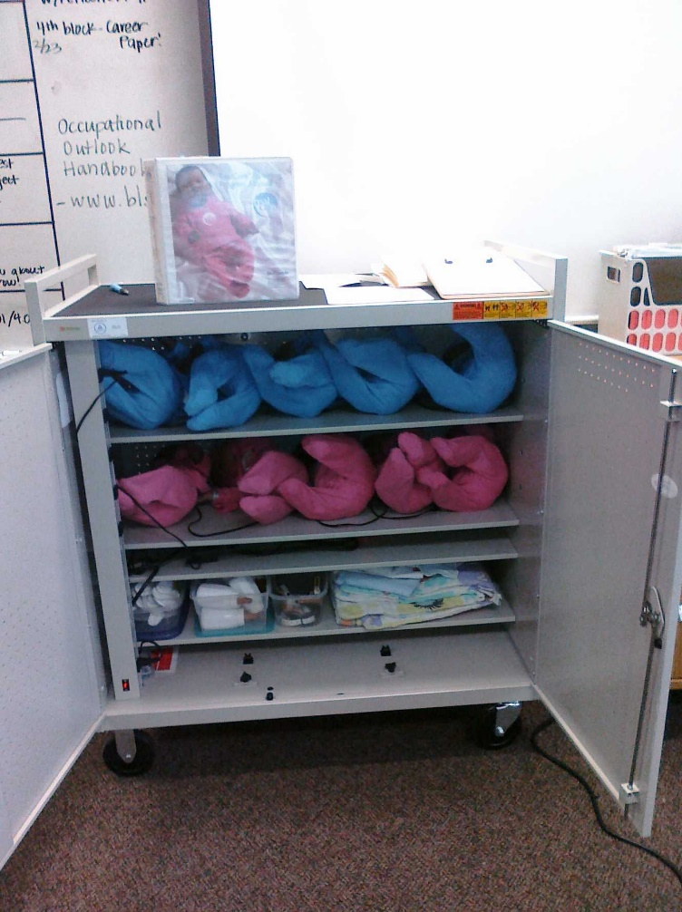
Babies, Supplies and Accessories
Notes:
Here is yet another alternative storage cart solution submitted by Suzanne Lujan, a Wake Co, NC customer. She is using a laptop cart and as you can see in the attached picture, she gets 10 babies in this with the bottles, etc as well. Having a cart on wheels make transporting Baby easy!

Slide 25
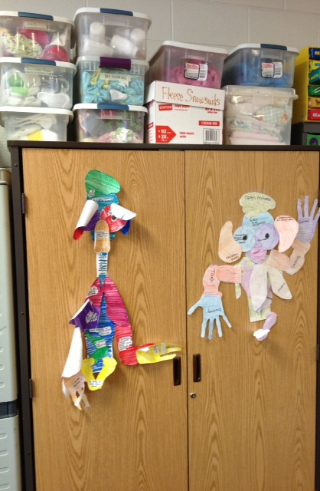
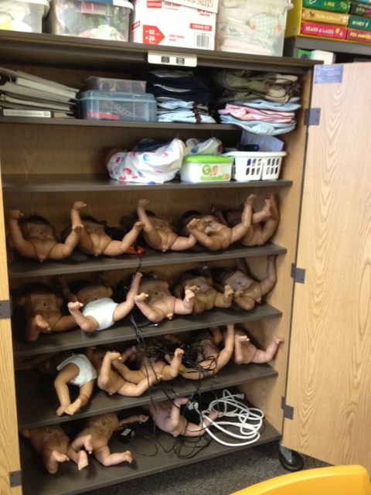
Babies, Supplies & Accessories
Notes:
This system was submitted by Laurel Meribela of Waterford, MI. She states, “ Here is the organization system we use for the 18 babies we own. Babies are stored in a cupboard that has wheels because we do use them between two teachers in two separate rooms. Plastic bins house all of the accessories and clothing, everything fits inside or on top of cupboard.” How cool is this?

Slide 26
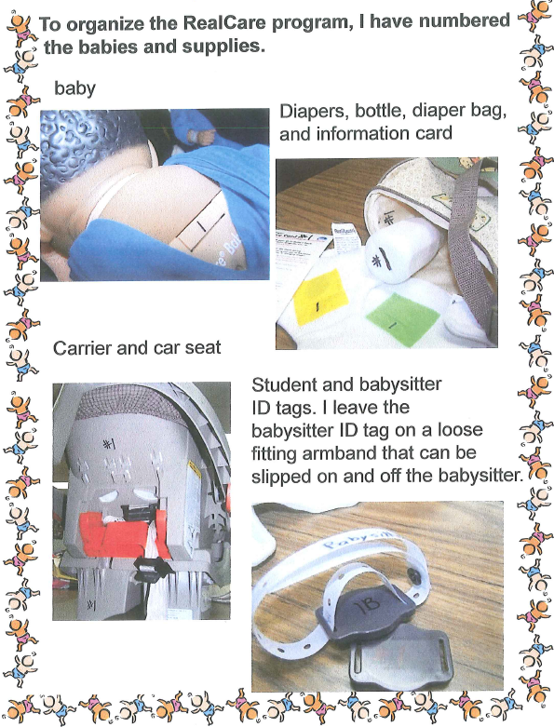
Labeling
Notes:
This experienced teacher has numbered all of her babies and supplies as you see in the photos above.

Slide 27
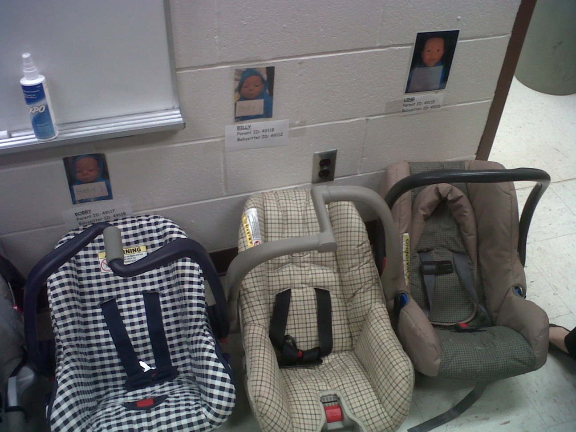
Storing Car Seats
Notes:
Car seat storage can take up space. Here one teacher has a large walk-in closet connected to her classroom. She has a photo of each Baby along with the Baby name taped onto the closet wall. Students can easily find the right spot to set down their car seat after the simulation experience.

Slide 28
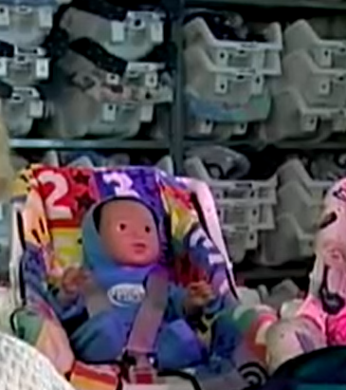
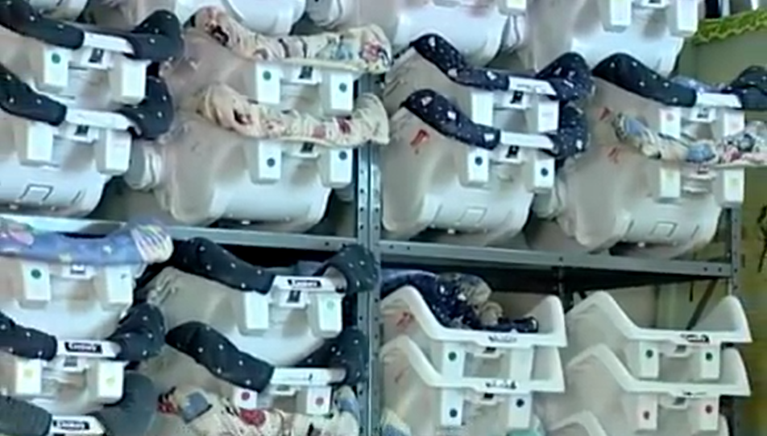
Storing Car Seats
Notes:
Here is a school that has many car seats stored on shelves. However, not all car seat models stack as neatly as these do. However, if you have the gift of many shelves in your room, stacking the carseats may make sense.

Slide 29
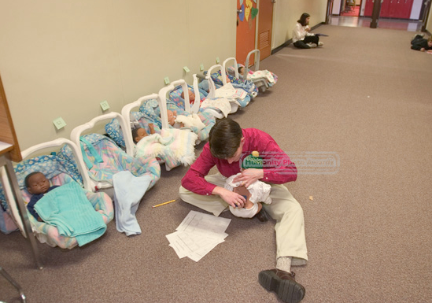
Using Car Seats to Organize
Notes:
Car seats can also be used to help keep supplies organized as well as students. This is one example where the instructor has each car seat lined up in the hallway with the student’s name on the wall and everything is ready to go in the carseat. When Friday afternoon rolls around, students come and get their IDs and Babies.

Slide 30
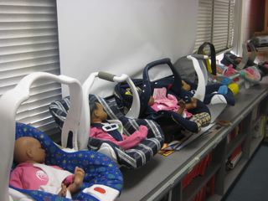
Using Car Seats to Organize
Notes:
Many classrooms are built with long countertops against the windows on one side of the room. This makes a great convenient space to set up carseats and have everything in them for each Baby.

Slide 31
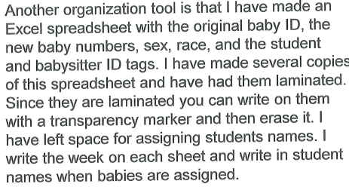
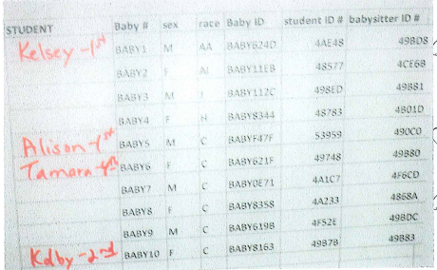
Checklists
Notes:
We had a teacher submit this idea to use. She laminates a spreadsheet with all pertinent Baby information and reuses them. It saves her time AND paper!

Slide 32
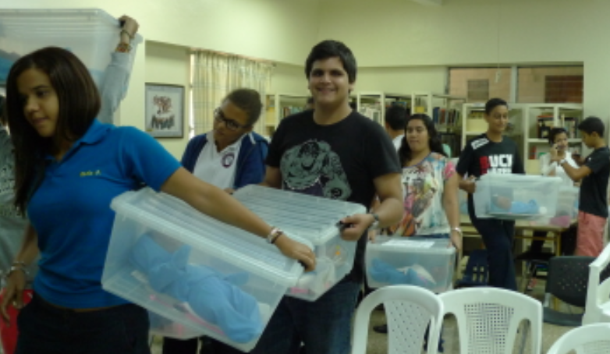
Keeping Students Organized
Using Totes
Notes:
Totes are a great way to keep everything together when handing baby out to students.

Slide 33



Slide 34
Realityworks Webinars
Realityworks’ educational webinars are designed to provide:
  Latest product information
  Program best practices
  Tips and tricks from experienced users and more.
Live, online presentations are led by product managers, curriculum specialists, product support technicians and other subject matter experts, and feature live demonstrations, customer examples and Q&A sessions.
For new or experienced users, you’ll find a number of webinars that can help you learn about our products, programs and curricula.
  http://realityworks.com/webinars
Notes:
Here are some free resources available for you. – first of all we have ongoing series of webinars that are free. You register and attend or receive the recording if you cannot attend. There are dozens of archived webinars on our website to access.

Slide 35

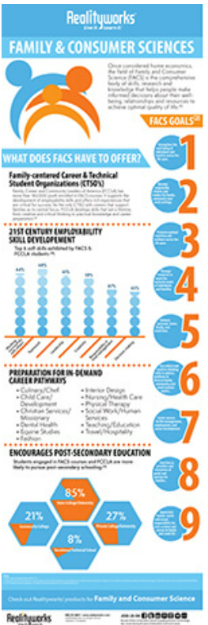
More FREE Resources
FREE infographics
https://www.realityworks.com/resources/realityworks-interactive-posters-downloads/
Tools to Prepare for Competitive CTSO Events
Notes:
There are more free resources for your classroom available at the following links – the first has several free FCS info graphics on careers
the second gives you access to several implementation guides -

Slide 36
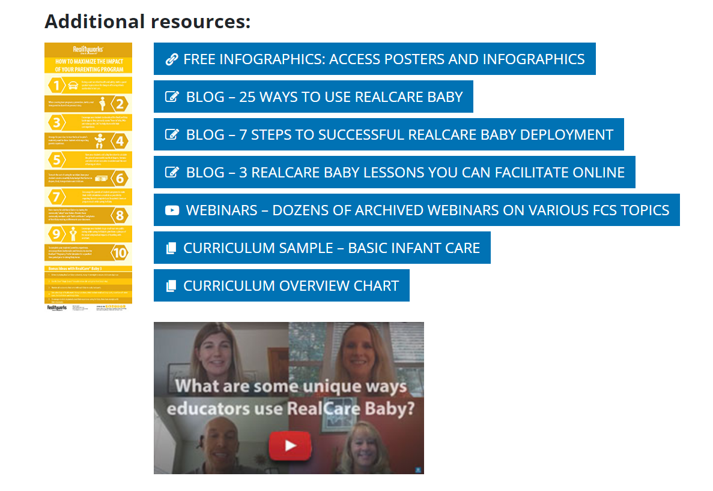
More FREE Resources
https://www.realityworks.com/rcb-implementation/
Tools to Prepare for Competitive CTSO Events
Notes:
There are more free resources for your classroom available at the following links – the first has several free FCS info graphics on careers
the second gives you access to several implementation guides -

Slide 37
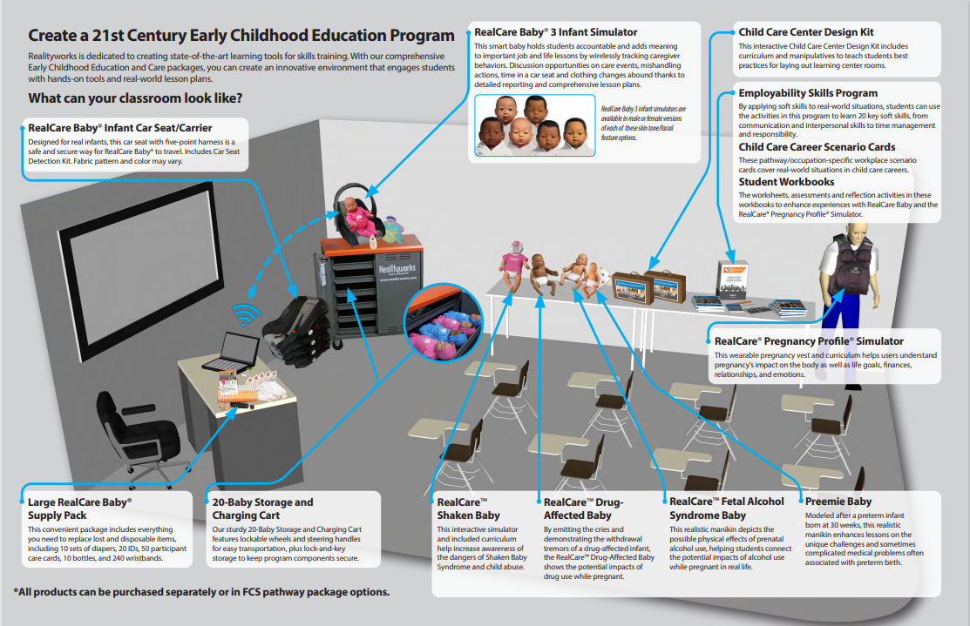
More FREE Resources
RealCare Program Implementation Resources
https://www.realityworks.com/rcb-implementation/
Tools to Prepare for Competitive CTSO Events
Notes:
There are more free resources for your classroom available at the following links – the first has several free FCS info graphics on careers
the second gives you access to several implementation guides -

Slide 38
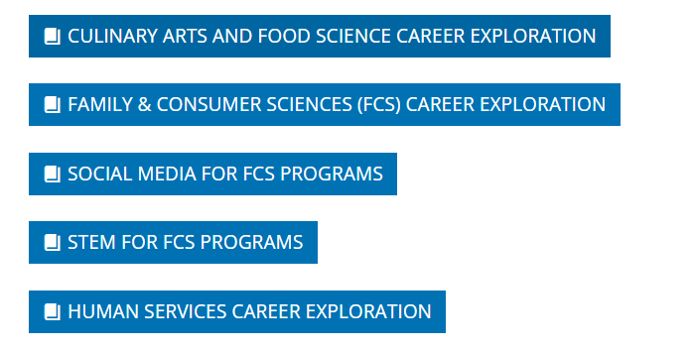

Free Career Exploration
https://www.realityworks.com/resources/free-lesson-plans/
Tools to Prepare for Competitive CTSO Events
Notes:
We have many free health science career exploration lessons. There are 5 lessons in each of these sets, for a total of 15, that connect students to a wide range of careers

Slide 39

Social Media
Realityworks Blog
  http://realityworks.com/blog/
Facebook
  https://www.facebook.com/realityworksinc
Twitter
  https://twitter.com/RealityworksInc
Experiential Learning Technology
Notes:
Realityworks wants to connect with you through social media as well.
Visit our blog for additional information from customers.
Like us on Facebook and follow us on Twitter to learn even more about our products and industry happenings

Slide 40

Q&A

