Slide 2
Teaching Soft Skills in Any Classroom:
Tips and Ideas for Student Engagement
Notes:
Welcome, everyone! Thanks for joining us today. My name is Emily Kurth, and I’m the Communications Specialist here at Realityworks.
At Realityworks, I’m primarily responsible for email marketing and content creation. One of the best parts of my job is speaking with teachers about how they use our hands-on training tools in their programs. Most of the tips I’m sharing with you today come directly from those teachers, who are finding creative ways to sneak soft skills practice into their classrooms, no matter what they teach.

Slide 3
Our agenda:
Overview of Realityworks, Inc.
What are soft skills, and why do they matter?
10 tips for incorporating soft skills into CTE classrooms
How Realityworks can help you address key soft skills
Notes:
That said, let’s review what we’ll discuss today.
We’ll spend the next 40 minutes or so…
Quickly reviewing what Realityworks is
Discussing what soft skills are, and what current research says on their importance
We’ll review 10 specific ideas you can use to teach these skills in your classes
We’ll conclude by reviewing the interactive training tools and resources Realityworks offers to engage students in soft skill development
I’m excited to share not only some great tips, but a bunch of free resources. Take notes as you’d prefer, but know that I’ll be sharing my slides, as Andrea said, with all attendees today so you’ll get the links and resource details that way, too.
With that, let’s begin!

Slide 4
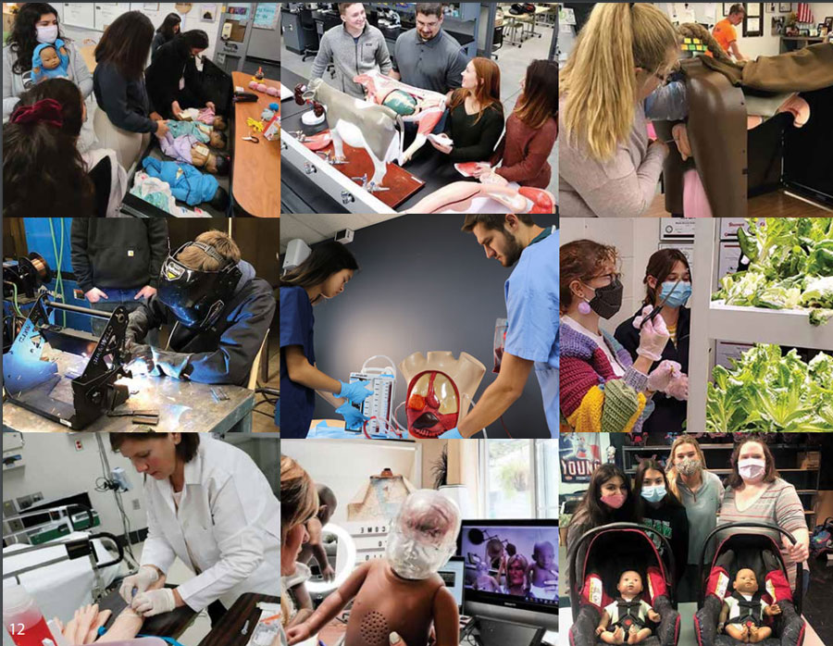
Who we are
Notes:
Realityworks, Inc., is an employee-owned company based in Eau Claire, Wisconsin, that creates experiential learning tools for teaching in-demand skills.
We got our start over 20 years ago, when former NASA engineer Rick Jurmain created the first RealCare Baby infant simulator, then went on to found the company that is now Realityworks.
Today, our comprehensive learning solutions combine curriculum with hands-on learning tools, student activities and assessments – we strive to create tools that are easy to implement into programs and offer plenty of customer support
These solutions are used in middle, secondary and post-secondary schools to address a variety of Career & Technical Education pathways, including health & human services, health sciences, welding and trade skills, agriculture education and of course soft skills!
Our simulators are in more than 70 percent of U.S. school districts and programs and in more than 90 countries around the world. Baby is still around, but now you can look to us for tools like our Bovine Birthing and Ultrasound Simulator, our ECG Simulator, our virtual reality welding simulators and even hydroponics systems.
One common theme that comes up whenever we speak with educators is SOFT SKILLS.
Over the years, we’ve found that educators from each of those program types share a common concern – ensuring that their students have the soft skills they need to succeed.

Slide 5

What are soft skills?
Enable someone to interact effectively and harmoniously with others
Considered the “bedside manner” of the workplace
Vital for ALL career paths!
Notes:
So, what are soft skills?
Soft skills, employability skills, job-readiness skills, emotional intelligence… there are many phrases used to describe these skills, but they all mean one thing: they are the personal attributes that enable someone to interact effectively and harmoniously with other people. They’re considered the “bedside manner” of the workplace
We’ve heard others say, and we agree – hard skills might get you in the door for an interview, but soft skills will help you get, and keep, a job. And most importantly, that concept applies for ANY job – soft skills are vital for all career paths.

Slide 6
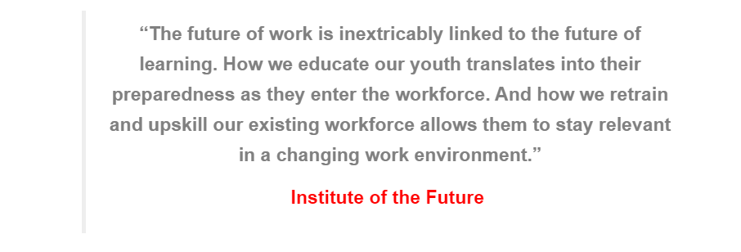
Source: https://knowledgecompass.com/post-covid-19-soft-skills-strategic-reemergence/
Notes:
Research shows that soft skills like teamwork, empathy, patience and critical thinking are used in offices and at worksites across the country every day, and that demand for these skills is growing.

Slide 7
Why do soft skills matter?
In 2014, CNBC reported that 44% of employers cited soft skills as the biggest gap in the US workforce
In 2019, LinkedIn’s Global Talent Trends report found that 92% of professionals report soft skills are as important as hard skills
Notes:
A poll conducted by CNBC in 2014 found that 44% of employers cited soft skills as the biggest gap in the US workforce.
Five years later, Linkedin's Global Talent Trends 2019 report found that 92% of professionals reported that soft skills are equally or more important to hire for than hard skills. Eighty-nine percent said that when a new hire doesn’t work out, it is due to a lack of critical soft skills.
In today’s post-pandemic workforce, we’ve found that soft skills have become more important than ever. After all, the way so many people work has undergone huge changes – many have been forced into different routines and new ways of connecting with colleagues. I’m presenting this webinar from home myself, as about 75% of Realityworks employees now work permanently from their home offices. For many, there’s been increased importance on time management and productivity skills.

Slide 8
Top 16 Essential Soft Skills
For The Future Of Work
Critical Thinking
Judgment and Complex Decision Making
Emotional Intelligence (EQ) and Empathy
Creativity
Collaboration and Teamwork
Interpersonal Communication Skills
Working in Gigs
Adaptability and Flexibility
Cultural Intelligence and Diversity Consciousness
Ethical Awareness
Leadership
Managing the Brand of YOU and Networking
Time Management
Curiosity and Continuous Learning
Embracing and Celebrating Change
Looking After Yourself
Source: https://www.forbes.com/sites/bernardmarr/2022/09/12/top-16-essential-soft-skills-for-the-future-of-work/?sh=493304d66151
Notes:
Just this past September, Forbes ran an article titled "The Top 16 Essential Soft Skills For The Future Of Work." The article focused on AI and roblts, but had some great takeways for all professionals - primarily that although workplaces will continue automating manual, repetitive tasks, people will still be critical for the tasks that rely on distinctly human skills that computers can’t yet replicate.
The author stated that these are the skills students should focus on acquiring and improving:
1. Critical Thinking
2. Judgment and Complex Decision Making
3. Emotional Intelligence (EQ) and Empathy
4. Creativity
5. Collaboration and Teamwork
6. Interpersonal Communication Skills
7. Working in Gigs – Navigating the gig economy (the flexible work environment of the future)
8. Adaptability and Flexibility
9. Cultural Intelligence and Diversity Consciousness
10. Ethical Awareness
11. Leadership
12. Managing the Brand of YOU and Networking
13. Time Management
14. Curiosity and Continuous Learning
15. Embracing and Celebrating Change
16. Looking After Yourself

Slide 9
10 ways to teach
soft skills in any classroom

Slide 10

TIP: Assign group work to foster teamwork
“I encourage teamwork in my classroom by having my students work together in groups to present valuable information to their fellow classmates. Sometimes information is received differently when it comes from your peers. This helps me understand their ability to work as a team and see who can be a team player.”
- Ashley Edmonds, Family & Consumer Sciences Teacher, Jack Britt High School, NC
Notes:
Teamwork skills include the mix of interactive, interpersonal, problem-solving and communication skills needed by a group of people working on a common task, towards a common goal.
In a conversation with NC FCS teacher Ashley Edmonds recently, she shared the benefits of teamwork in her FCS classroom. Any assignment that involves collaboration will help your students hone their ability to work in teams.
Teaching in-person? Assign in-class time to research a topic and present as a group. Require that each student spend an equal amount of time presenting a different portion of the information.
Teaching online? Students can still be responsible for scheduling their Zoom meetings, during which they can work together to conduct research or create a group PPT presentation.
Emphasize the value of teamwork by debriefing! Recommended questions include:
How did you feel during the activity?
What challenges did you face?
What did your team have to do or believe to be successful?
What positives can you take away from the activity?

Slide 11
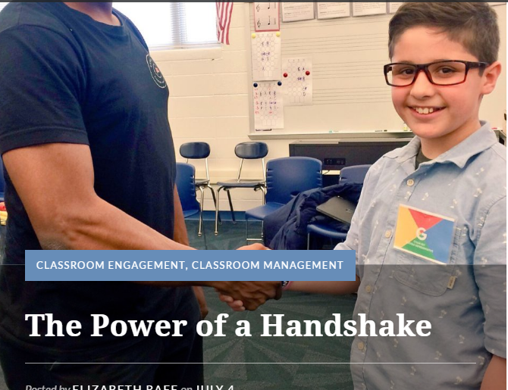
TIP: Begin each class with an elbow bump
Do it daily!
Ensure the encounter includes eye contact and a polite greeting
See it in action:
https://www.youtube.com/watch?v=lQzAKjhaESY&list=UUn8MB_VIq4ZoK3mxZ-1cSig&index=2
Notes:
A good handshake is a skill that can make a huge impression in any setting, particularly a business one – and you can help your students start to hone that skill right away by starting each day with a handshake – or these days, an elbow bump or virtual high five.
Teaching in-person? Begin by starting each day bumping elbows or offering an “air” high-five, while maintaining good eye contact and a smile, you’re accomplishing several things:
Teach students “best practices” of a polite greeting: eye contact, firm elbow bump and a smile
Give students REGULAR opportunities to practice a very basic soft skill
Also speaks to your relationship with your students – they see you taking the time to personally greet them every da
Teaching remotely? Encourage each student to take a turn high-fiving their webcam, ensuring that in the moments before or after they are also maintaining eye contact, smiling and offering a confident “good morning” or “good afternoon.” With each student, return the greeting individually.

Slide 12
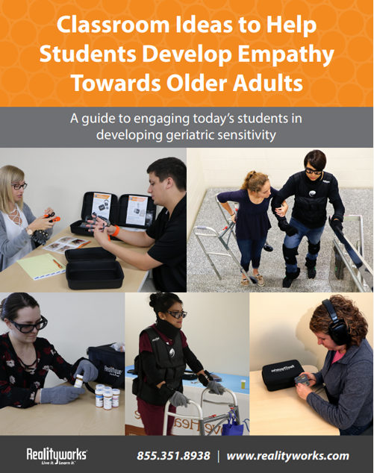
TIP: Cultivate empathy
  “With every lesson concept, reminders on the importance of empathy should be built in. Use case studies and simulation to prepare them to handle uncomfortable topics. Personally, I also like to include exam questions on selecting the best empathetic response or professional behavior for the situation. We need to help our students build that human-to-human connection.”
  Kasey Carlson, MSN, MEd, Nursing Curriculum Technology Manager, WI
  Free guide: Classroom Ideas to Help Students Develop Empathy Toward Older Adults
  Download: https://www.realityworks.com/geriatric-training-tools/
Notes:
Empathy is the ability to identify with another person by sharing in their perspective and feelings. This soft skill is commonly valued in the helping professions, like counseling and social work, but can bring great value to teams in all professions by helping develop camaraderie and trust.
This is why WI nursing instructor Kasey Carlson recommends cultivating empathy at every opportunity, whether it’s through a reading, a simulation, group discussion or another activity.
Teaching in-person? Assign a reading and have students pair up to discuss their feelings on the topic. They can present their thoughts to the class to foster a larger group discussion, or summarize their discussion in a written report.
Teaching online? Students could complete a video assignment, then pair up using video conferencing tools to discuss their feelings on the topic. They can present their thoughts to the class via a recorded video, a Zoom presentation or a writing assignment submitted via an LMS system.
FREE GUIDE – We created a free guide featuring ideas for getting students thinking about the challenges older individuals face on a daily basis. Download yours for free by visiting our website: https://www.realityworks.com/geriatric-training-tools/

Slide 13
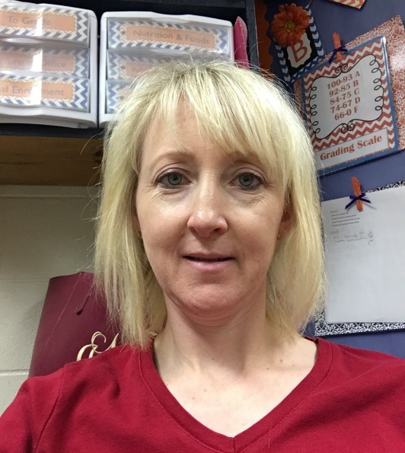
TIP: Add relevancy with real-world examples
  “My high school students may have jobs at Pizza Hut, Raising Canes, McDonald’s, etc., but soft skills are still needed in those jobs. As I teach students about their future professions, we discuss how soft skills are used in their current jobs. For instance, teamwork and communication are needed to keep food safe as one person cooks burgers to the correct temperature, and another prepares and serves it the proper way.”
  - Jennifer Hebert, culinary teacher, Beau Chene High School, LA
Notes:
The more relevant you can make your lessons, the more your students will engage with the content and connect what you’re teaching them with their own futures.
This is why LA culinary teacher Jennifer Hebert recommends incorporating real-world examples about how your students are already using soft skills every day.
You can do this by giving students the chance to stand up and share a soft skill they use each day at their job or athletic activity, along with a time they feel that skill made a difference.
For those teaching online, you can conduct the same exercise via Zoom, or have each student create a PowerPoint slide illustrating their example.

Slide 14

TIP: Incorporate scenario-based learning
Classic scenarios: Job interviews, dealing with customer complaints, handling disruptive clients, marketing new products
New ideas: Incorporate technology, debate, bring in others
Free guide: Using Scenario-Based Learning To Explore Career
Download here: https://www.realityworks.com/sample-scenario-cards/
Notes:
Scenario-based learning experiences like role-playing Role play is great for many reasons – it builds confidence, promotes self-esteem, and of course, it’s a great method of student-driven, active learning, which we know today’s students crave.
Classic scenarios include role-playing job interviews, dealing with customer complaints, handling disruptive clients, marketing new products
New ideas we’ve learned from educators include:
Proposing a “21st Century dilemma:” Do you answer a text in the middle of a staff meting? Check Facebook at work? Answer the phone during work hours
Debate: You finish your assigned task at work. Do you go home early or do you find other tasks to accomplish? (Motivation)
Debate: You’re presented with several tasks, all of which need to be accomplished by the end of the day. How do you prioritize when working from home? What would you do differently if you were working from home?
Be creative. Instead of going off a predetermined dialogue, give your students prompts and allow them to be creative.
Bring in others. Invite teachers, administrators or even community members to participate
FREE GUIDE – We created a free guide of ideas for using scenario-based learning to encourage career exploration and promote skill development. Visit our website to download your own copy for free!

Slide 15

TIP: Practice professionalism daily
Suggested requirements:
  Arrive on time
  Come prepared
  Use proper spelling and punctuation
  Dress for success
The key is consistency
Set clear expectations
Lead by example
Notes:
I was recently in an Illinois welding teacher’s classroom, and the instructor, who had come from industry, was lamenting the fact that his students couldn’t communicate, didn’t know the value of showing up on time, etc.
Well, a great place to start developing those skills is in the classroom – especially if they are not experiencing those requirements anywhere else. By demanding professionalism, you’re setting your students up to succeed in the workplace
That said, the key here is consistency.
Every day, make sure your students know they’re expected to:
Arrive on time
Come prepared
Use proper spelling and punctuation
Dress for success
Now, we know you might not be able to do every one of these items every day. The idea is to mimic an office environment, and get your students used to those professional habits.

Slide 16

TIP: Implement networking activities
Time the interactions
Use pre-planned questions or cue cards
Debrief afterwards:
  How much did you learn?
  Did it feel like a conversation?
  What made it easier or more difficult?
Notes:
A nursing instructor once told me that she starts every CNA course with a networking activity.
Students par up to ask each other specific personal questions, then they must introduce each other to the rest of the class. For her, this activity not only helps her get to know her students, but it creates an atmosphere of familiarity that makes it easier for her students to collaborate later in the semester as they practice clinical skills.
This tip may have come from a nursing instructor, but networking and teamwork are important skills for all students. These types of activities, even brief ones, give students a chance to practice their interpersonal communication skills and build self-confidence.

Slide 17

TIP: Make intentional assignment tweaks
Notes:
New research tells us that the ability of a company to adapt has been called the new competitive advantage – and the same is true of individuals. These days, demand is growing for employees who can adapt to an ever-changing workplace, who is open to new ideas, and who doesn’t panic when things don't go according to plan.
How can you encourage this trait in your students? Intentional assignment tweaks is one way. I was recently interviewing some digital communications students at our local tech college, and they were telling me how quickly they had to adapt pre-planned social media posts when their professor intentionally changed the theme of the week at the last possible minute. She did this on purpose – she wanted them to have the opportunity to practice that adaptability and adjust to change – and it stuck with them. They had to scramble to create and schedule content and adjust their calendars accordingly… and the experience stuck with them. Intentional assignment tweaks, changes half-way through, can help your students learn how to be flexible and adapt to change, two important soft skills.

Slide 18

TIP: Make time for reflection
Before something important (or are expected to do something)
During something important
After something important
Notes:
Reflection engages critical faculties and allows information to become meaningful knowledge, and it helps build an in-demand soft skill: Critical Thinking.
When can you encourage reflection? The fun thing about reflection is that it’s something people have to learn and practice… the more you do it, the stronger your students’ critical thinking skills will be!
Try to incorporate reflection opportunities, like journaling:
Before something important - students could run through what they already know about a topic just before you begin discussing it in class
Do it during a long-term project or task to give them an opportunity to assess their own understanding and reflect
Assessment after a learning experience – asking students what did they learn, what stumped them, whether alone or as a group activity – can give them (and you) feedback on the experience and again, encourage them to make connections.
In today’s world, your students are constantly moving, from screen to screen and activity to activity. Giving them time to reflect will not only help them develop critical thinking skills, but create valuable habits that can help them succeed in the workforce.

Slide 19

TIP: Practice giving and receiving feedback
Set expectations
Use a feedback rubric
Keep it anonymous
Moderate and review feedback from students
Notes:
According to a 2017 analysis by the Wall Street Journal, U.S. colleges are falling short when it comes to teaching students critical thinking skills like assessing evidence, interpreting data and making cohesive arguments.
Peer review and peer-to-peer feedback can be an effective way to help students develop those skills – plus, it increases student engagement and helps them see the relevancy of what they’re doing, who important concepts for today’s 21st century students.
To do this in your classroom, consider the tips on your screen:
Set expectations – it’s about helping, not judging
Use a feedback rubric fine-tune the process and encourage specific suggestions.
Keep it anonymous so students to encourage comfort and anonymity.
Moderate feedback to ensure it remains fair and helpful. Start with a small, short assignment, like the introduction to an essay or an assessment worksheet.

Slide 20
How we can help you address key soft skills

Slide 21
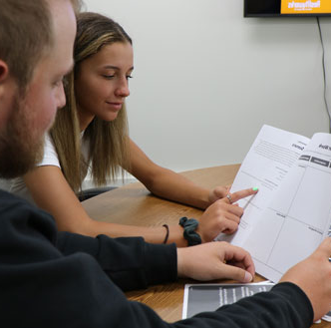
Employability, leadership skills programs
Programs include teacher guides, student workbooks, slide presentations and scenario cards
Learn more: https://www.realityworks.com/
soft-skills-implementation/
Notes:
These are our original soft skills programs, designed to offer out-of-the-box solutions to teaching key employability skills like communication, teamwork and time management as well as leadership skills like trust, coaching and mentoring and conflict resolution.
Each program includes lessons specific to individual soft skills.
Each lesson also gives students the chance to apply each of these skills 2-4 times per lesson
For instance, the first skill listed is communication. In these lessons, we get into verbal communication, non-verbal communication and even written communication where students learn tow rite a business letter
In the time management lesson, participants begin by learning how to prioritize tasks and identify and overcome barriers to time management. Then they’re given the chance to dig into their own personal schedules and determine how they’re truly spending their time, and identify the changes they can make in order better manage their own time.
There’s truly a breadth of content in both of these programs!

Slide 22
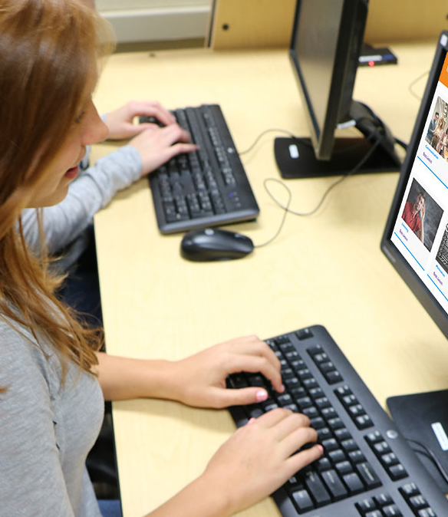
Online Employability and Leadership soft skills programs
Web-based options
Designed for any classroom
Real-world scenarios and activities
Self-paced and interactive
Variety of license lengths and terms
Free trials available
Learn more: https://www.realityworks.com/soft-skills-implementation/
Notes:
New within the last two years are our two web-based options for teaching soft skills: An Employability Skills Program that covers 19 key soft skills like communication, teamwork and time management. We also offer an Online Leadership Soft Skills Program, which covers 18 different leadership skills like trust, coaching and mentoring and conflict resolution.
I encourage you to visit our website and try a fee trial You’ll get access to a single lesson from each program and the accompanying instructor guides.

Slide 23

NEW: Contemporary Entrepreneurship Program
Online and paper-based formats available
Addresses a plethora of topics, including how to generate ideas, conduct market research and write a business plan
Includes lessons, workbooks, activities and more
Learn more: https://www.realityworks.com/soft-skills-implementation/
Notes:
We’re particularly excited about our new Contemporary Entrepreneurship Program!
With this program, students will learn how to be an entrepreneur, generate ideas, conduct market research, consider legal and financial issues and write a business plan. The unit ends with a Shark Tank-like Product Pitch Day, which we encourage you to invite local professionals to join. It even comes with student workbooks and vocabulary cards, assessments, and more. Check it out, or try the free trial of the online version on our website!

Slide 24

Soft skills activity cards
Written by industry professionals
Themed around specific careers
Key questions are included
Free samples: https://www.realityworks.com/
sample-scenario-cards/
Notes:
Finally, our Career Scenario Cards are great options for quick ice-breaker activities, discussion activities and more! These interactive cards feature real-world scenarios from specific careers, so students can practice soft skills within the context of actual jobs.
If you’re wondering how these cards might fit into your curriculum, visit our website! You can three free activity cards for four CTE pathways - agriculture, health science, trade skills and Family & Consumer Sciences – to preview the activities and test them out for yourself.

Slide 25
Now what?
Free infographic:
https://www.realityworks.com/resources/realityworks-interactive-posters/
Free guide: Free Guide: 5 Ideas for Incorporating Soft Skills Into any Classroom: https://www.realityworks.com/soft-skills-implementation/
Free lessons:
  https://www.realityworks.com/blog/12-easy-entrepreneurship-activities-for-any-class-plus-3-free-lessons/
  https://www.realityworks.com/blog/3-free-lessons-to-help-students-develop-power-skills/
Notes:
Now that we’ve hit you with all of this great information, what do you do?
Try one of the tips I shared today – it’s ok (and easier) to start small!
Visit our website to access a free poster on the top 20 soft skills today’s employer needs
Then, take a moment to check out our other free resources, like a guide for incorporating soft skill activities (more ideas, yay!) and to explore our soft skills training tools.

Slide 26
Questions?

