Slide 1
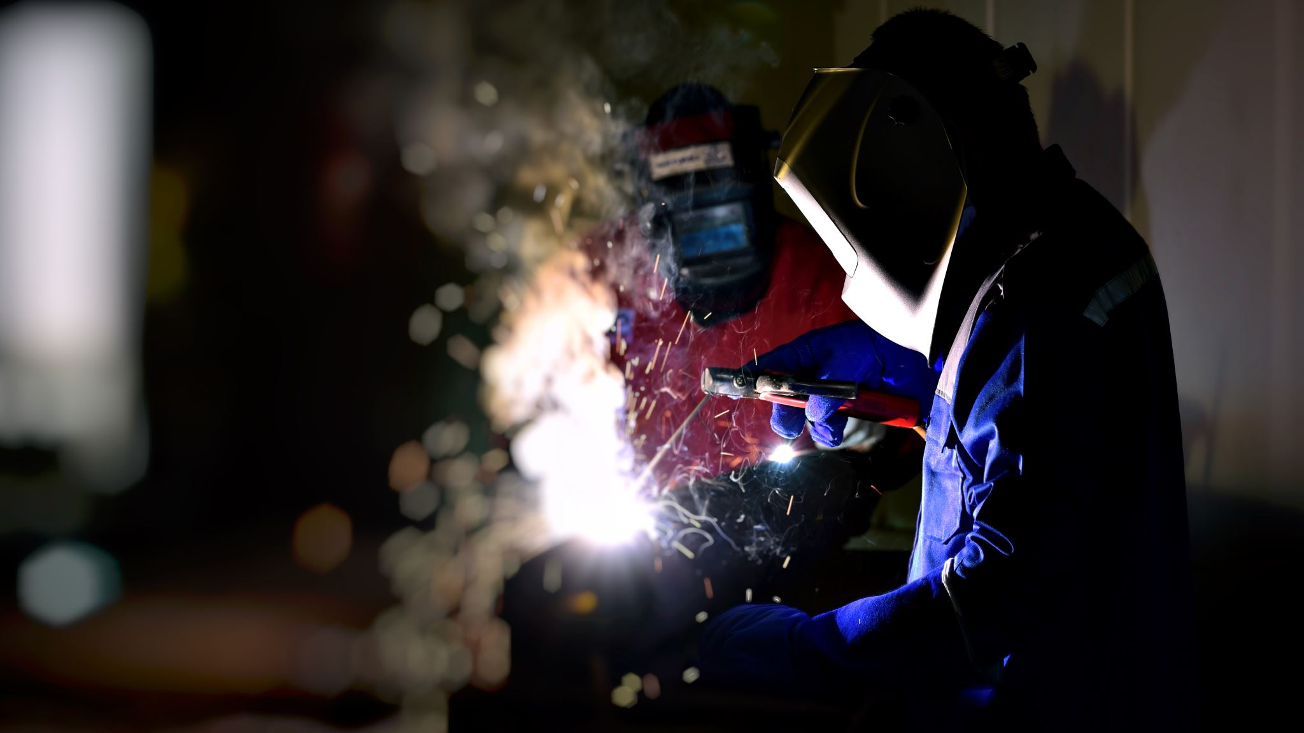

Teaching Welding: Foundations Related to Advanced Manufacturing and Construction Careers

Slide 2
Who is Realityworks?

Slide 3
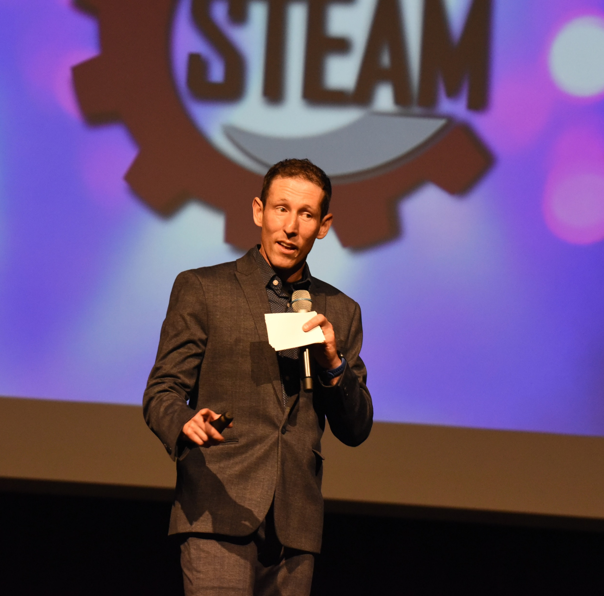
Todd Hunter
STEM & Career Exploration Product Manager
Todd.Hunter@Realityworks.com

Slide 4
Engaging Career Path Experiences Your Students Will Love
Understand the role of welding as a foundational skill for high-demand career industries.
Design engaging, career-connected learning experiences that align welding instruction with real-world applications and student career goals.
Integrate hands-on tools and simulators to enhance student engagement, safety, and skill development.
Notes:
Today is all about connecting our students learning experiences with relevant, future career paths. We are going to look at 4 different career paths and identify solutions that you can implement in your classroom to connect students to those opportunities.

Slide 5
Engaging Career Path Experiences Your Students Will Love
guideWELD VR
guideWELD Live
Weld Defects Kit
Common Welding Joints Kit
Bend Tester

Slide 6
Why is welding foundationally important for trades and engineering careers?

Slide 7
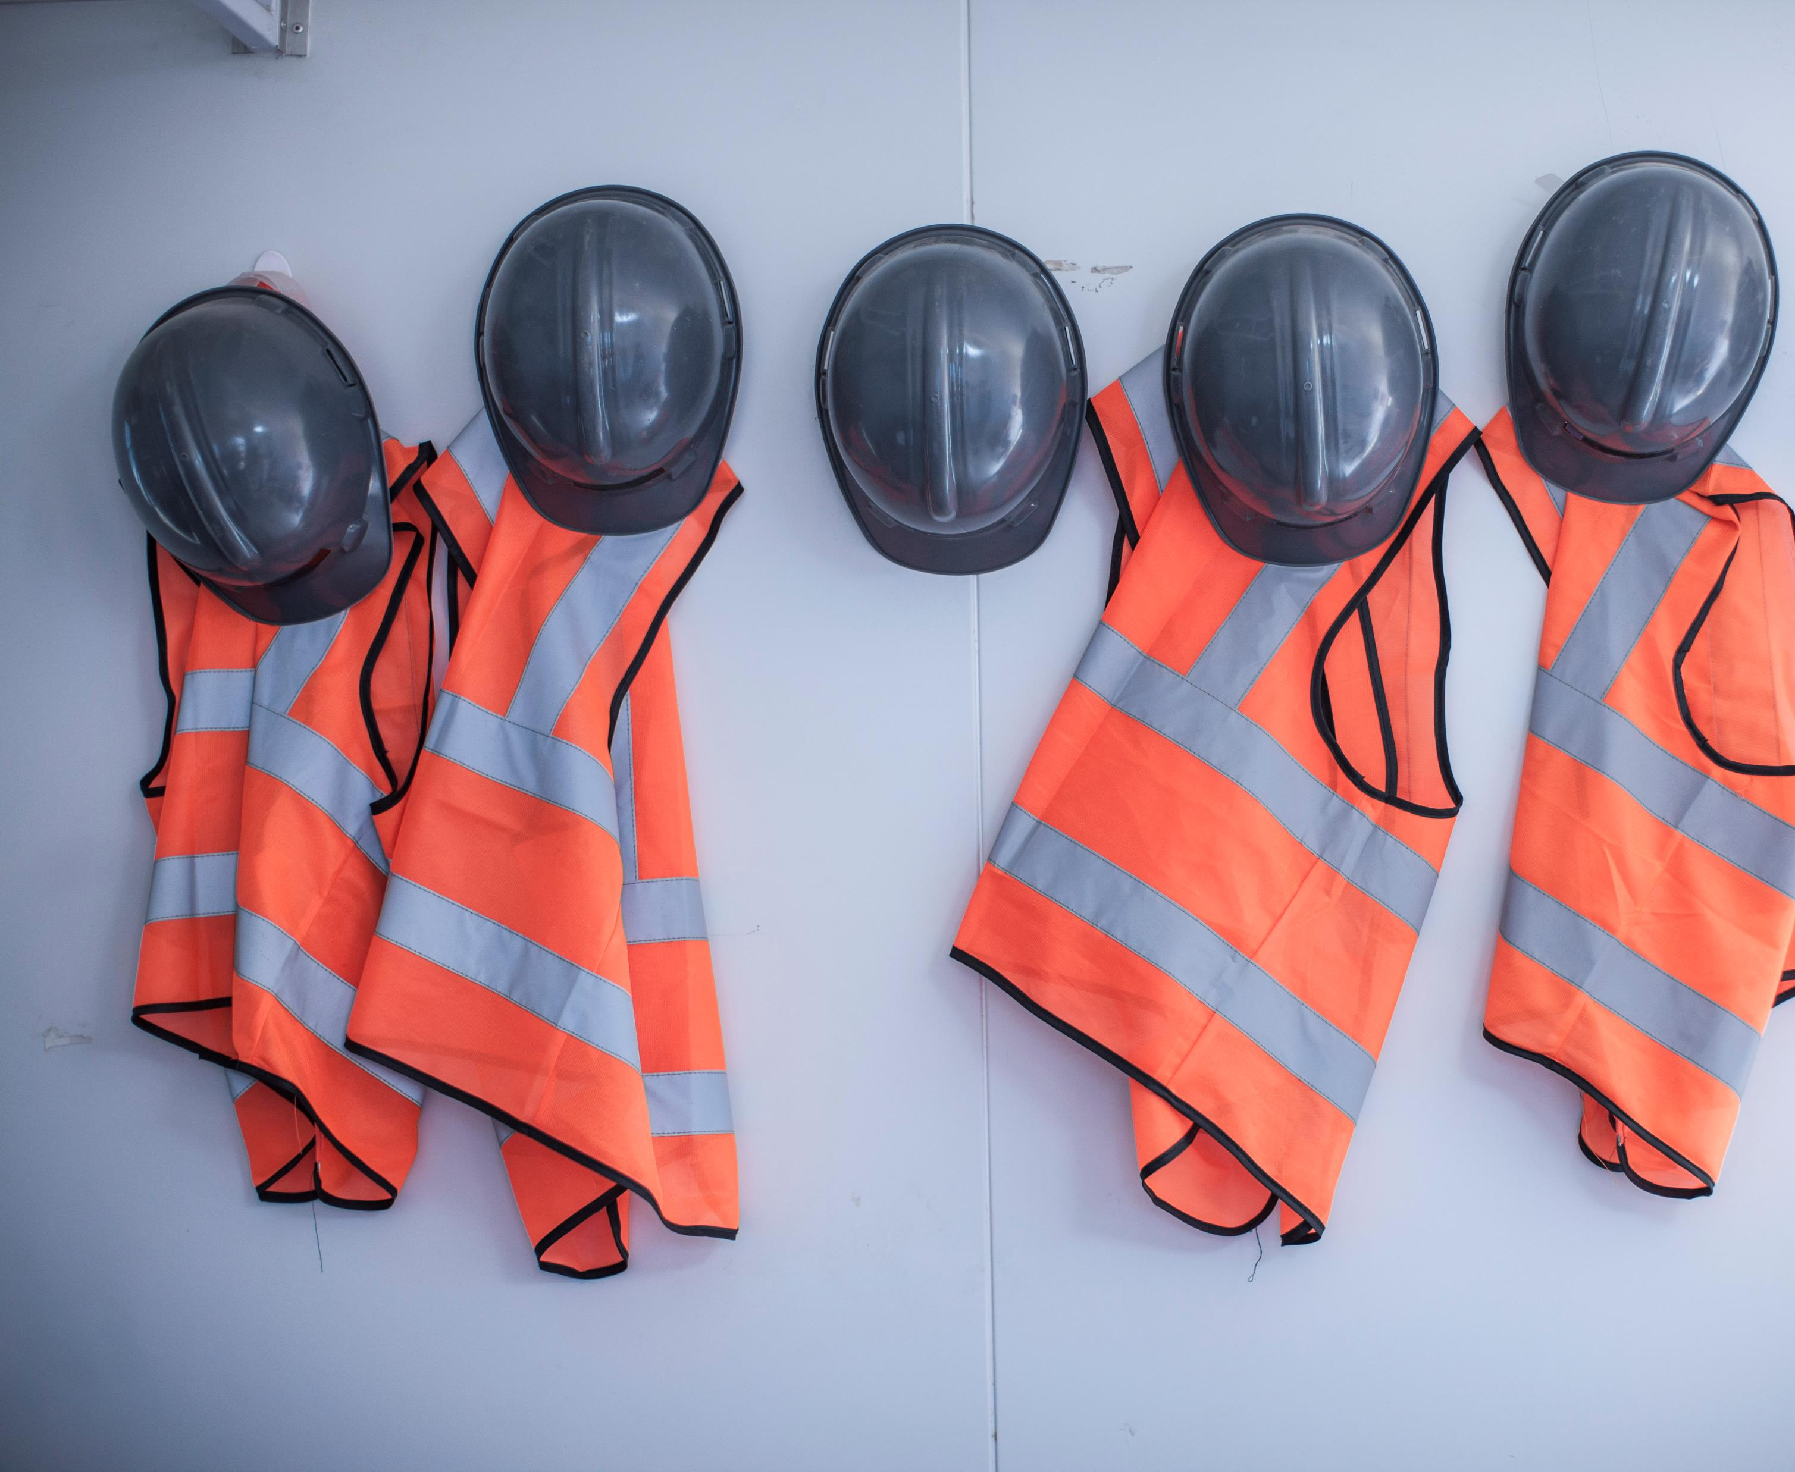
Universality Across Careers
Welding is used in construction, manufacturing, automotive, aerospace, shipbuilding, plumbing, HVAC, and more.
Learning it opens doors across multiple industries.

Slide 8
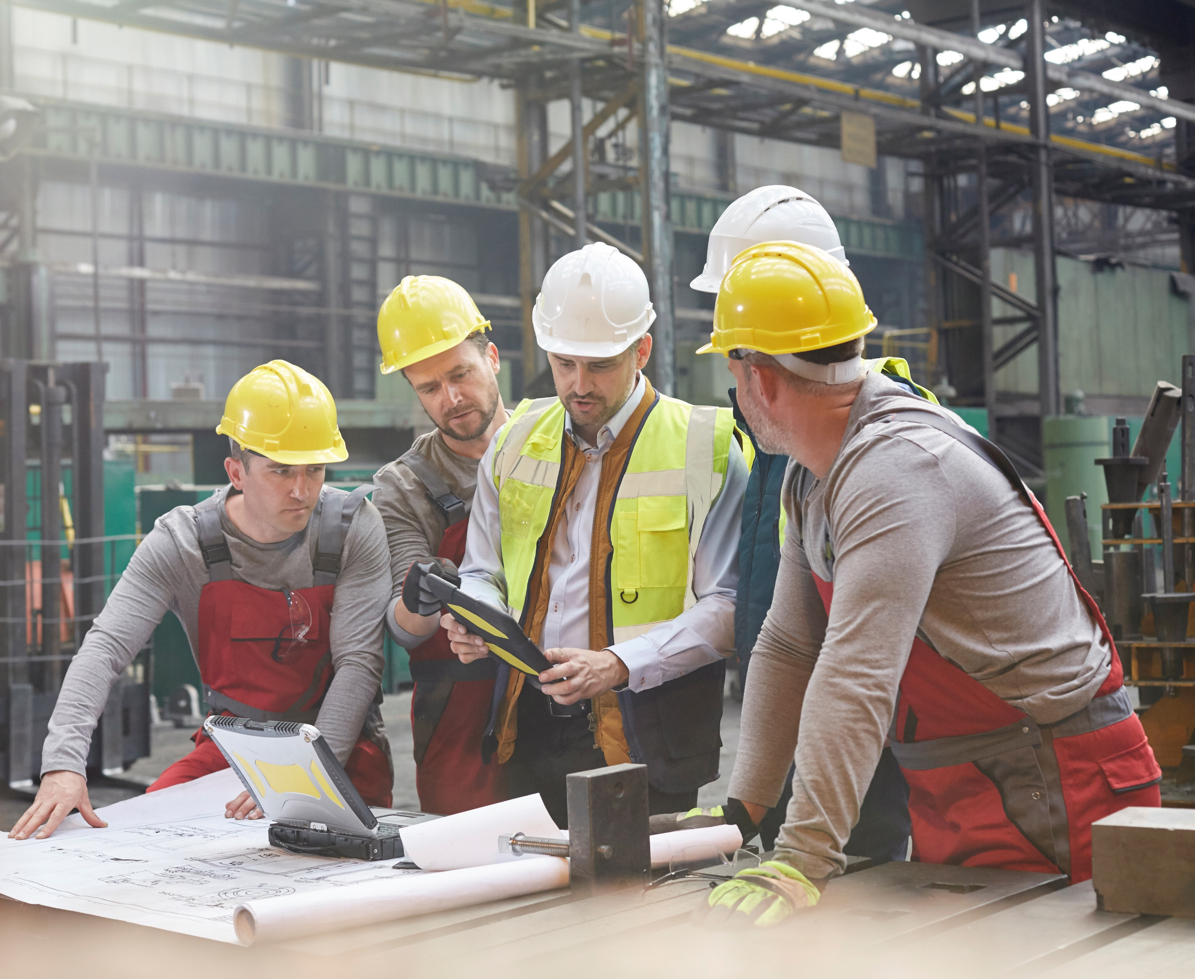
Blueprint and Technical Drawing Literacy
Welding requires reading blueprints, schematics, and technical drawings, which builds foundational skills in spatial reasoning and technical communication—critical for engineering and skilled trades.

Slide 9
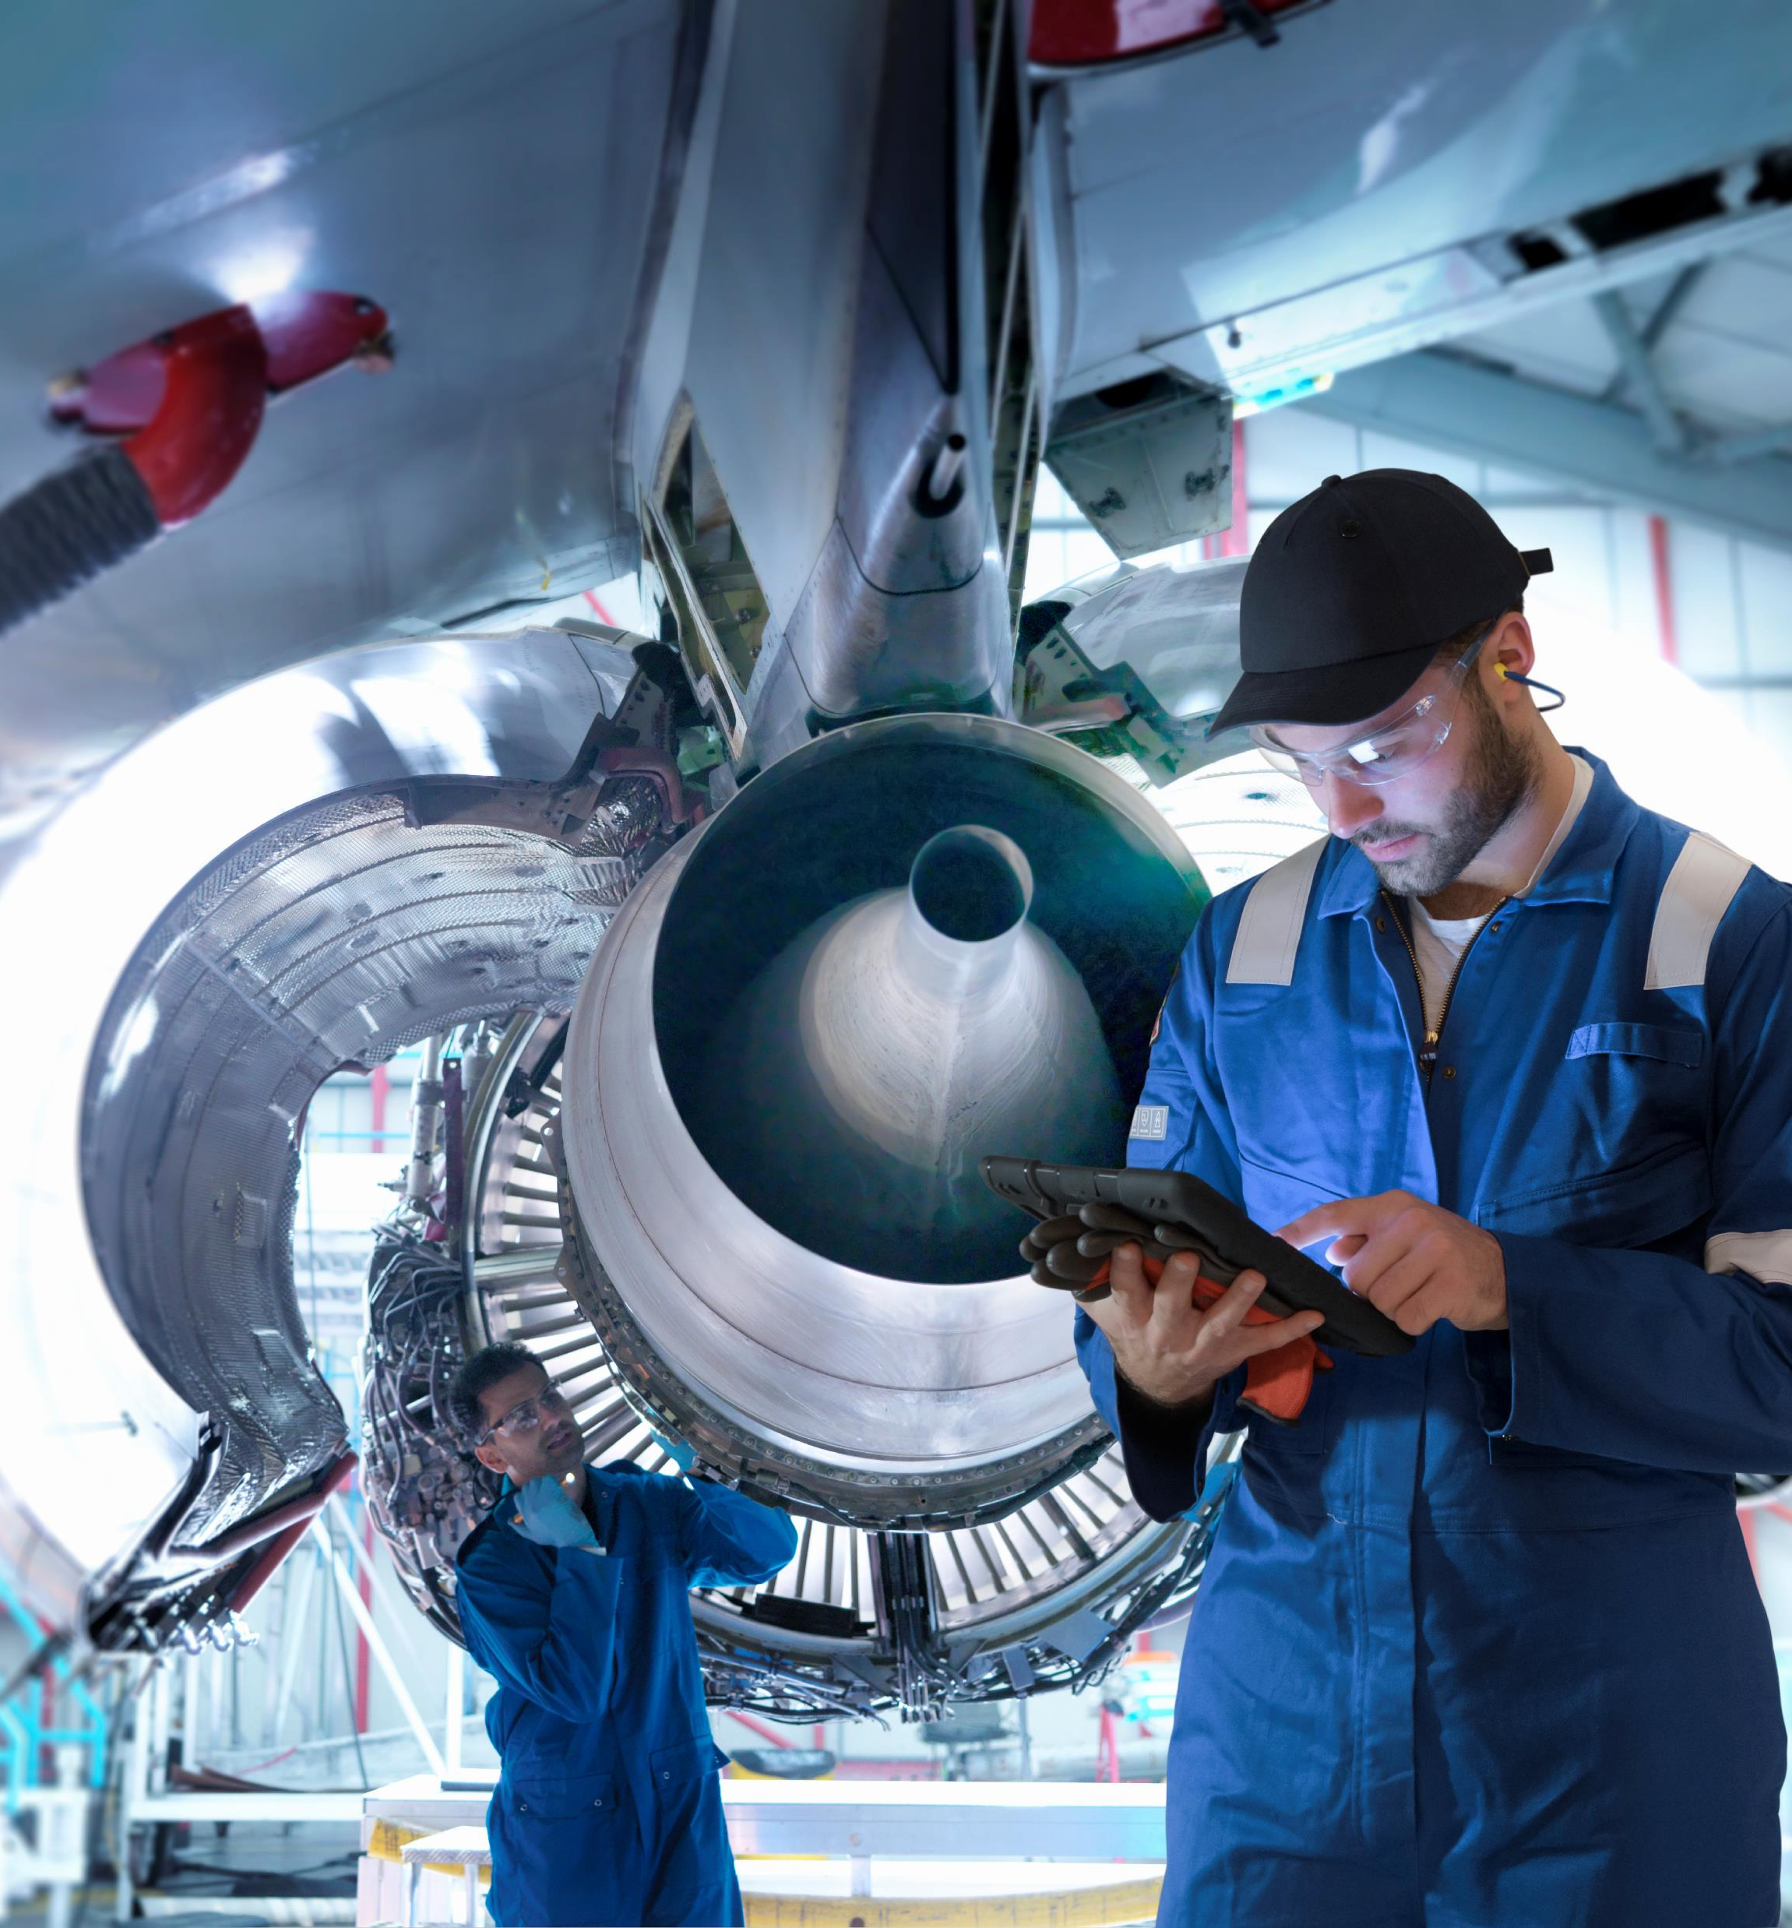
Materials Science Understanding
Welding introduces learners to metallurgy, heat treatment, and material behavior, which are essential concepts in mechanical, civil, and materials engineering.

Slide 10

Precision and Attention to Detail
Welding demands high precision, fostering habits of accuracy and quality control that are vital in both engineering design and skilled trades.

Slide 11
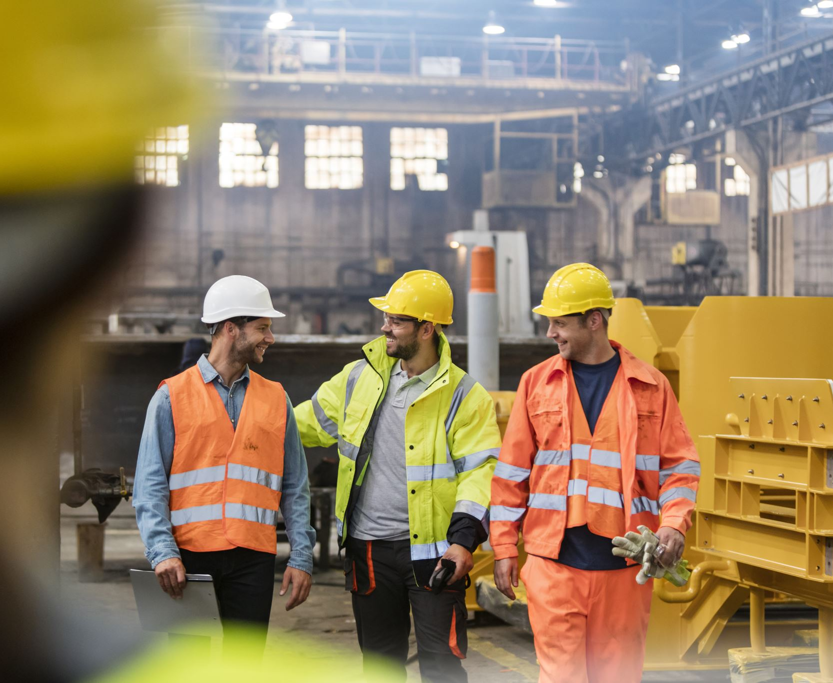
Safety Awareness
Welding teaches rigorous safety protocols, including PPE use, hazard identification, and fire prevention—skills that are transferable to any industrial or technical setting.

Slide 12
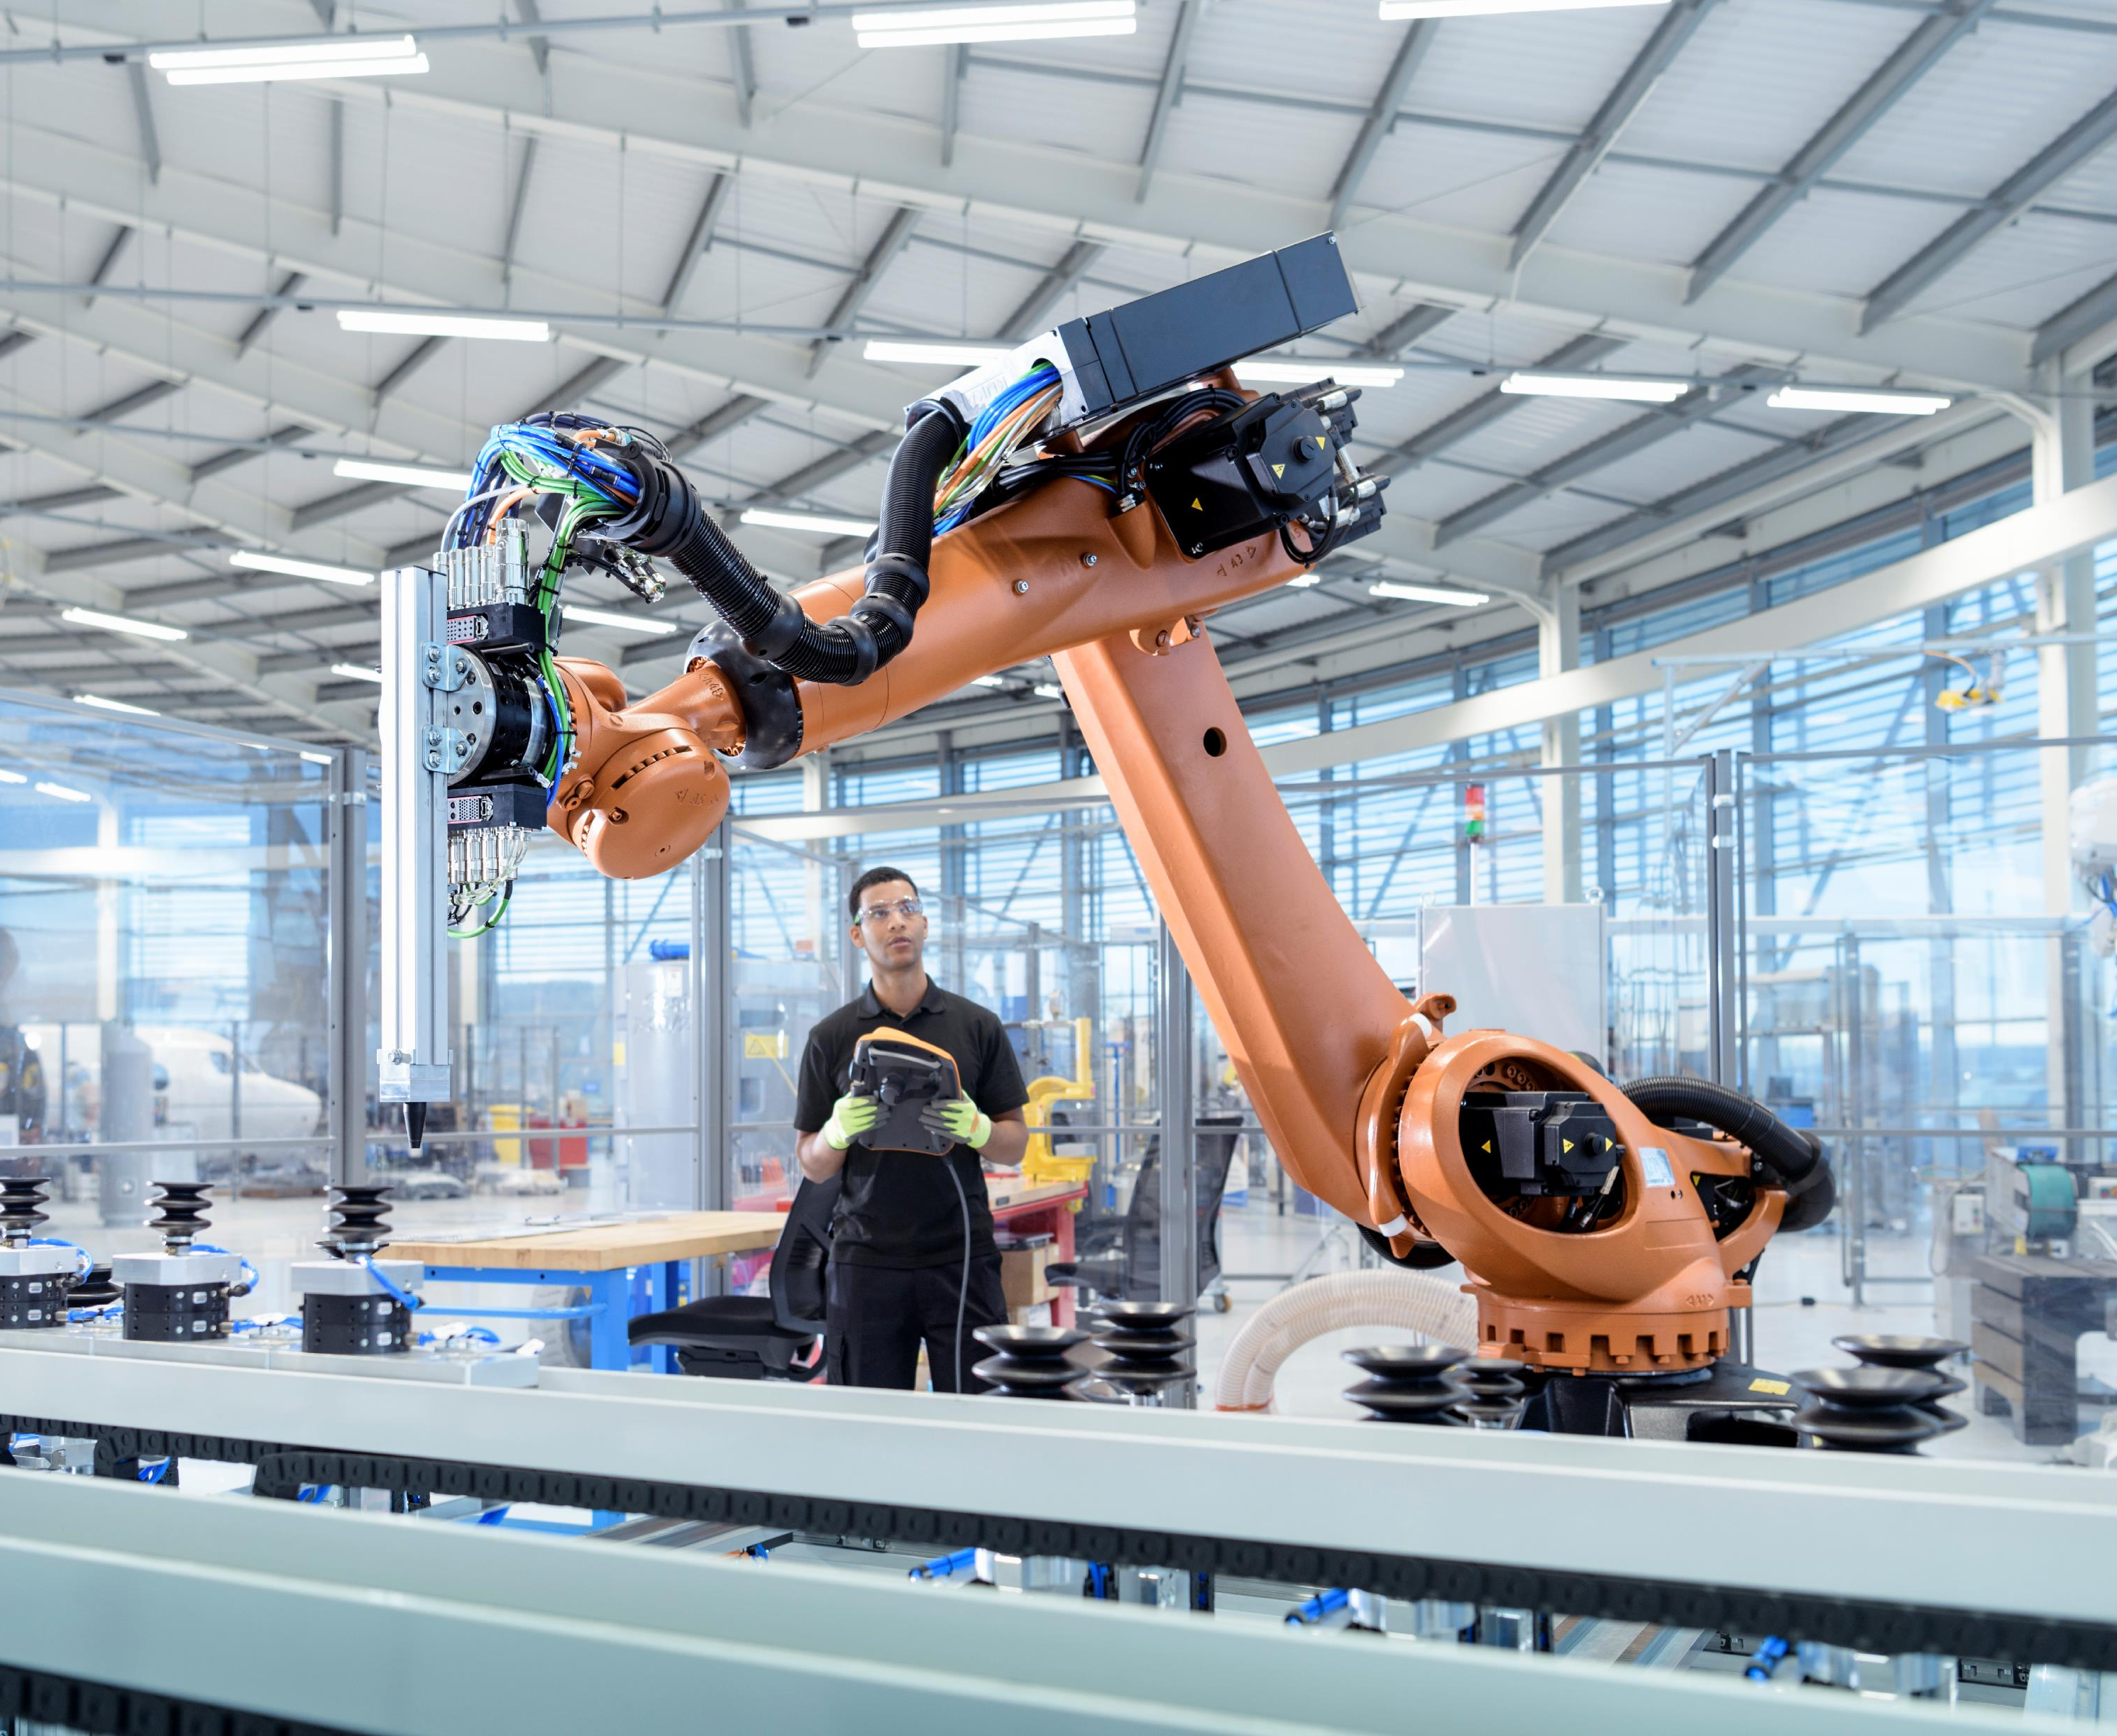
Integration with Future Technology
Modern welding involves automation, robotics, and CNC systems, giving learners exposure to cutting-edge tech and preparing them for Industry 4.0 environments.

Slide 13
Career Outlook: Welding Professionals
The American Welding Society (AWS) projects a need for 320,500 new welding professionals by 2029, with 80,000 jobs to be filled annually between 2025–2029.
AWS reports a national median salary of $55,600.

Slide 14
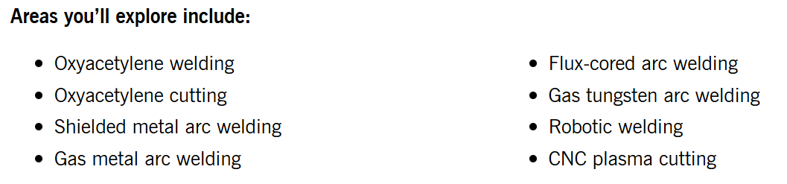
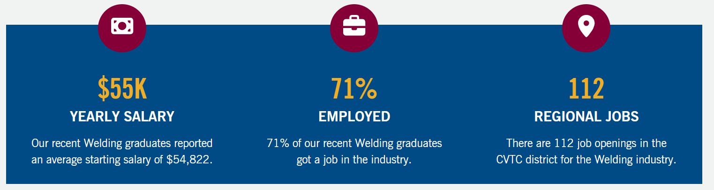
Post-High School Training
1 Year Welding Program @CVTC:
Cost = $8,394

Slide 15
Why Welding?
Gateway Skill

Slide 16
How do we help our students find success in welding?

Slide 17
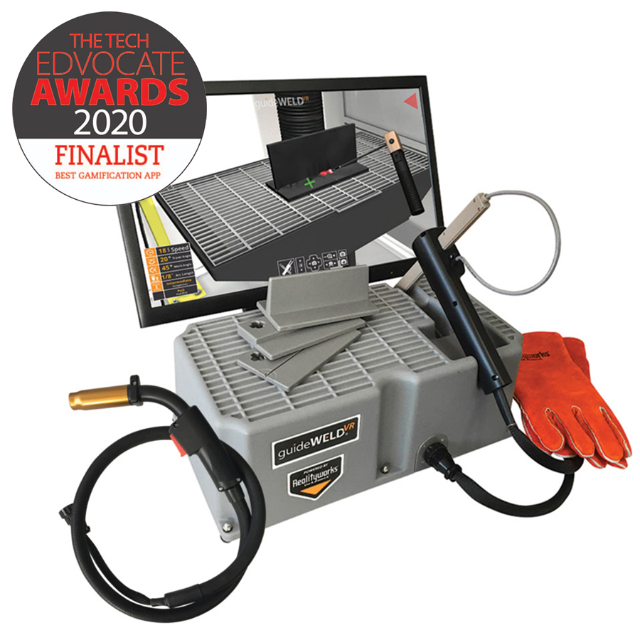

Before the Booth: guideWELD VR
Great for in-class training, demonstrations, remote learning, and recruiting students to your classes
Mimics an “in-booth” experience
Easy to facilitate whole-class viewing
Immediate feedback on work and travel angles, speed, nozzle-to-plate distance, and straightness
MIG and/or stick welding processes available
3 difficulty levels: novice, intermediate, and advanced

Slide 18
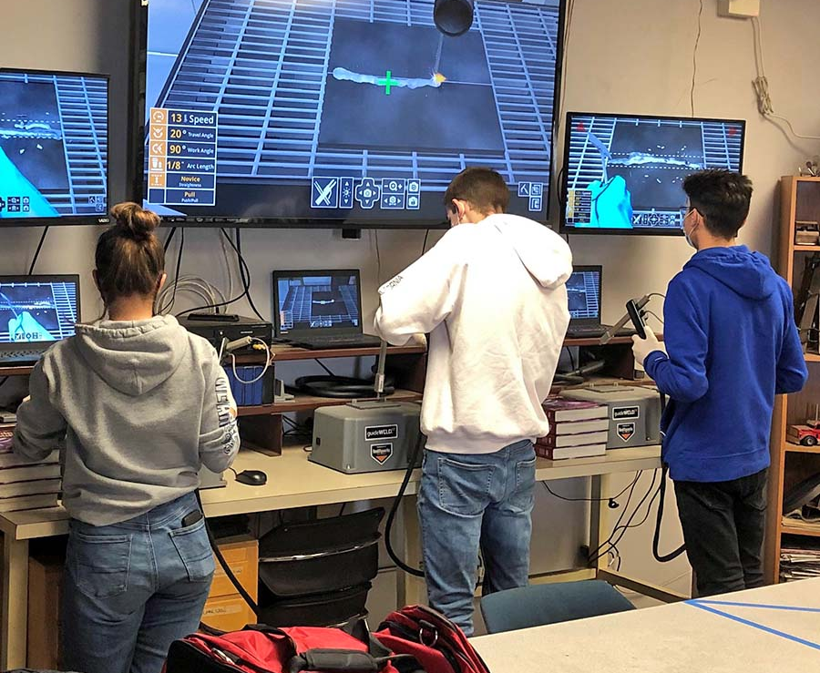
Before the Booth: guideWELD VR
Easy installation on Windows and MAC operating systems
No licensing fees or requirements
Curriculum covers welding careers, safety, techniques, equipment, and defects
Saves on consumables and materials
Fits in crowded classrooms and standard welding booths
Works with standard gloves; no need for a helmet

Slide 19
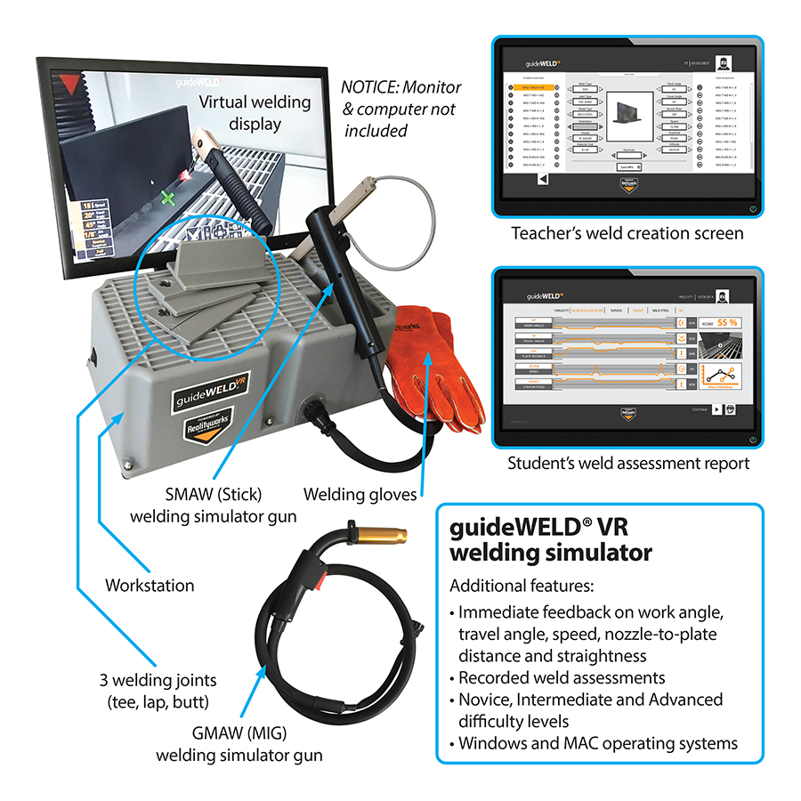
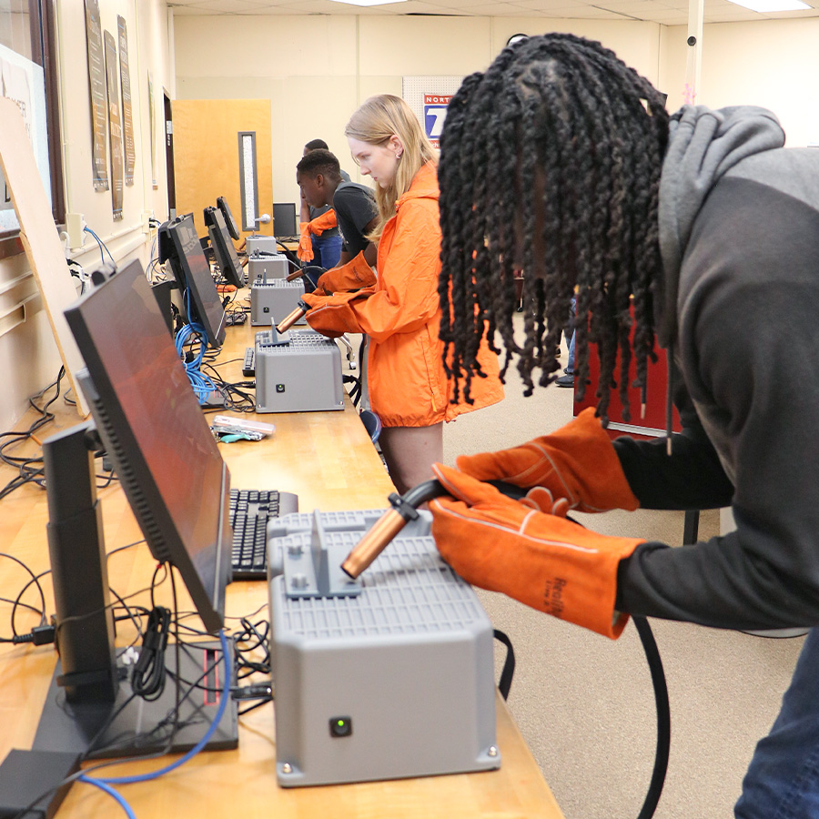
Before the Booth: guideWELD VR

Slide 20
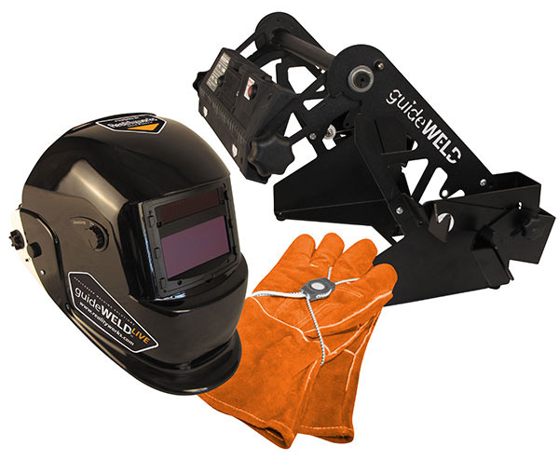
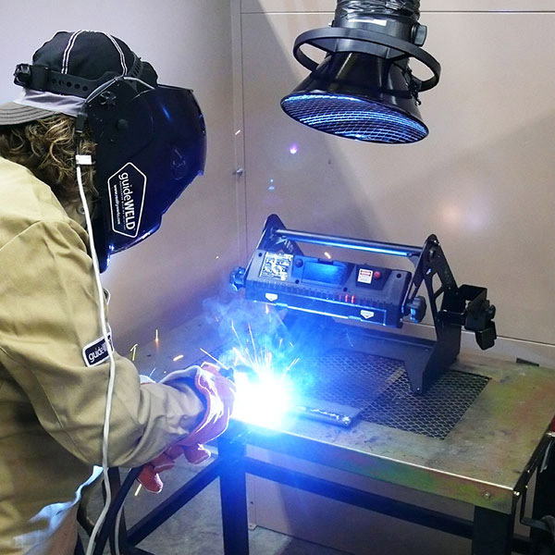

In The Booth: guideWELD LIVE

Slide 21
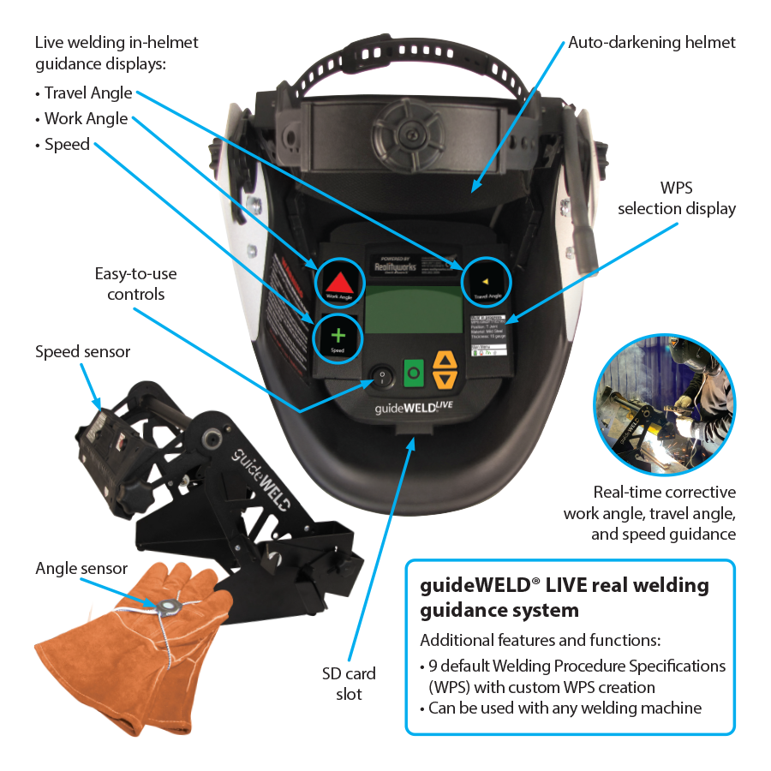
In The Booth: guideWELD LIVE
Works with any MIG or stick welder
Ideal for transitioning users from classroom to welding booth
Great for in class training, demonstrations, and remote learning
Provides a peripheral-view display inside the welding helmet during live MIG and stick welding
Offers real-time feedback on work and travel angles as well as travel speed during live welding
Includes 9 default WPSs and option for custom WPS creation

Slide 22
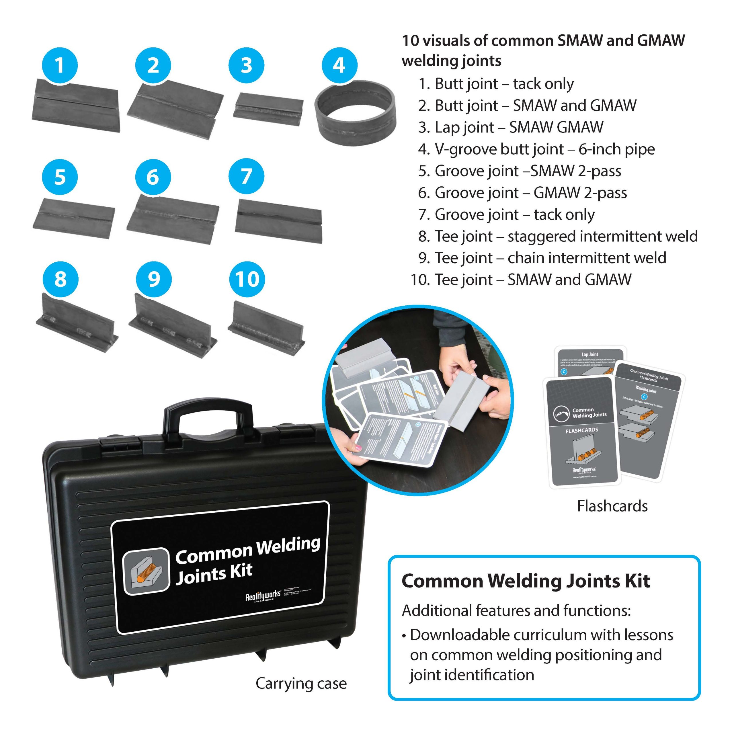

After The Weld: Common Welding Joints Kit
Is This Right?

Slide 23
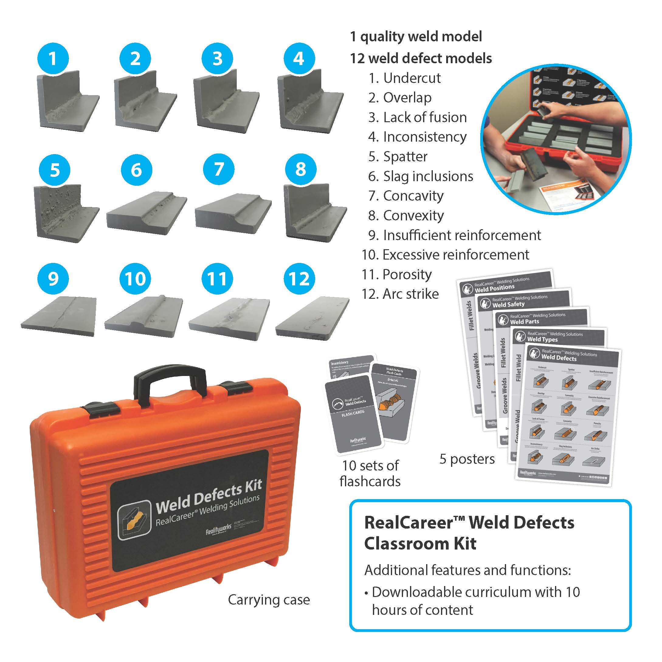

After The Weld: Weld Defects Kit
What Did I Do Wrong?

Slide 24
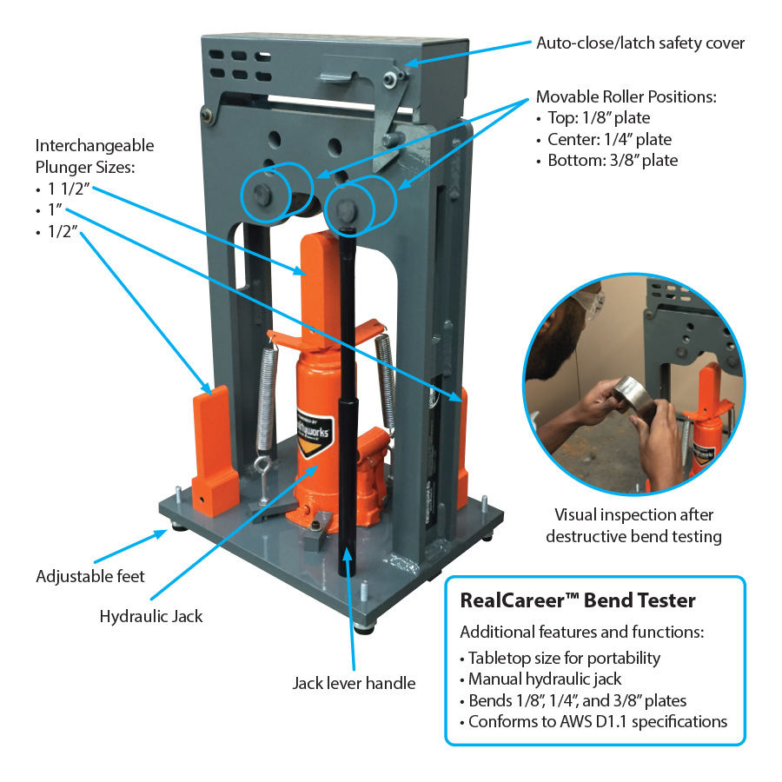

Prepare for Certification: Bend Tester
EXPLORE
Hidden Details of a Weld’s Quality
Standardized Evaluation: Often part of formal welding qualification tests (e.g., guided bend tests in AWS D1.1)

Slide 25
Complete Learning Experience
Before The Booth: guideWELD VR
In The Booth: guideWELD Live
Is This Right? Common Welding Joints Kit
What Did I Do Wrong? Weld Defects Kit
Prepare for Certification: Bend Tester

Slide 26
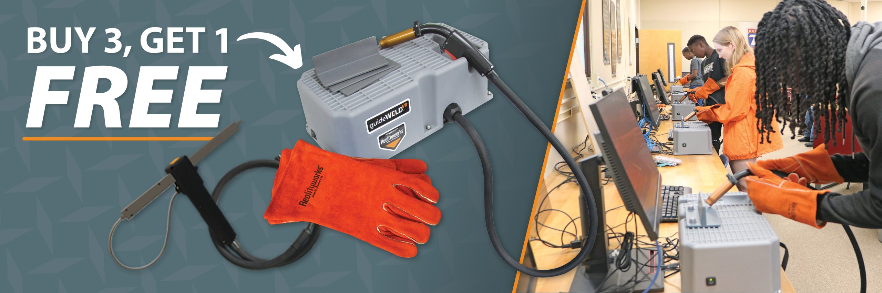

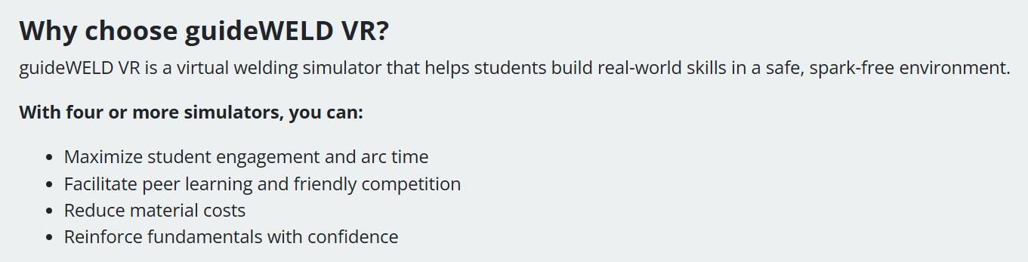
Special Offer: Buy 3, Get 1 FREE

Slide 27
Questions?
Before The Booth: guideWELD VR
In The Booth: guideWELD Live
Is This Right? Common Welding Joints Kit
What Did I Do Wrong? Weld Defects Kit
Prepare for Certification: Bend Tester

Slide 28
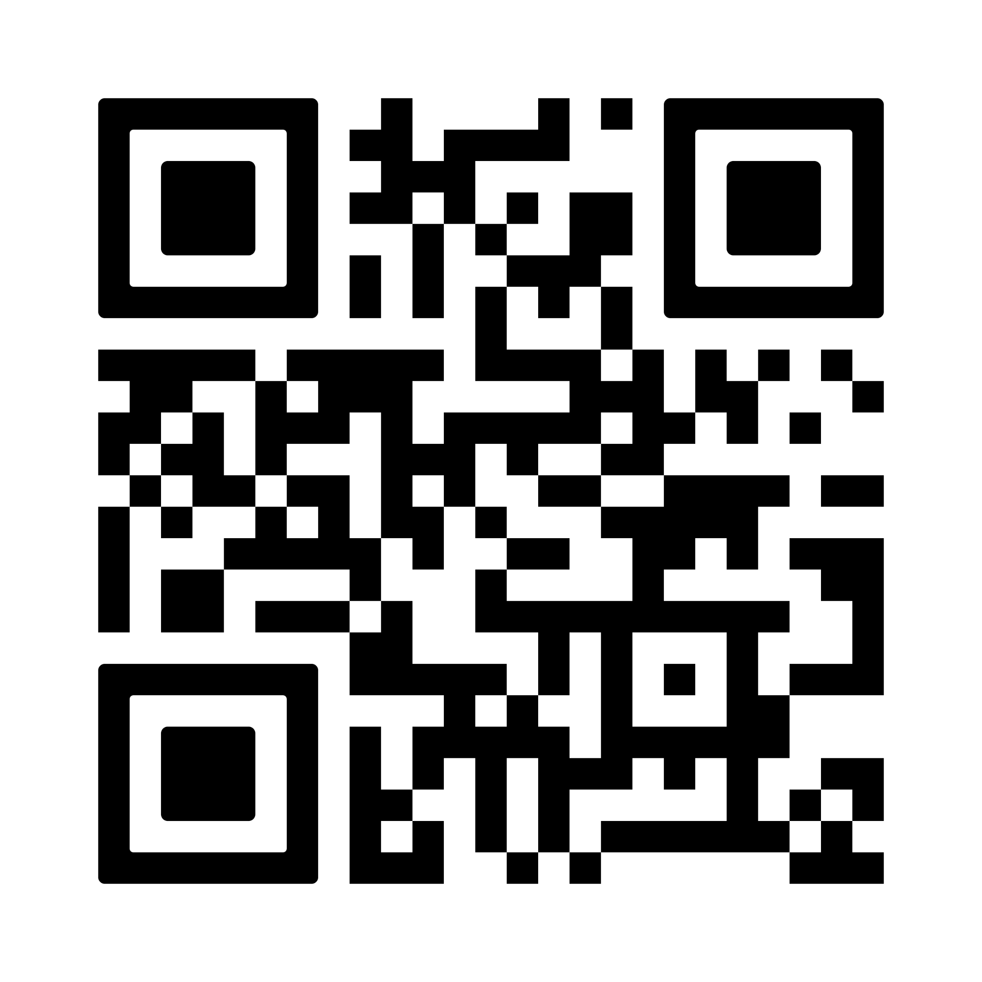
Let’s connect!
We can help you start or refresh your own program!
Scan to:
Connect with your local Realityworks account manager
Request a free quote
Ask questions and more

Slide 29
Todd Hunter
STEM & Career Exploration Product Manager
Todd.hunter@realityworks.com

